Slide 1

1. Ge₂Sb₂Se₄Te on SiO₂: A Tunable Monolithic Platform for Integrated Photonics with Large Thermo-optic Coefficient
GSST on SiO₂

Slide 2
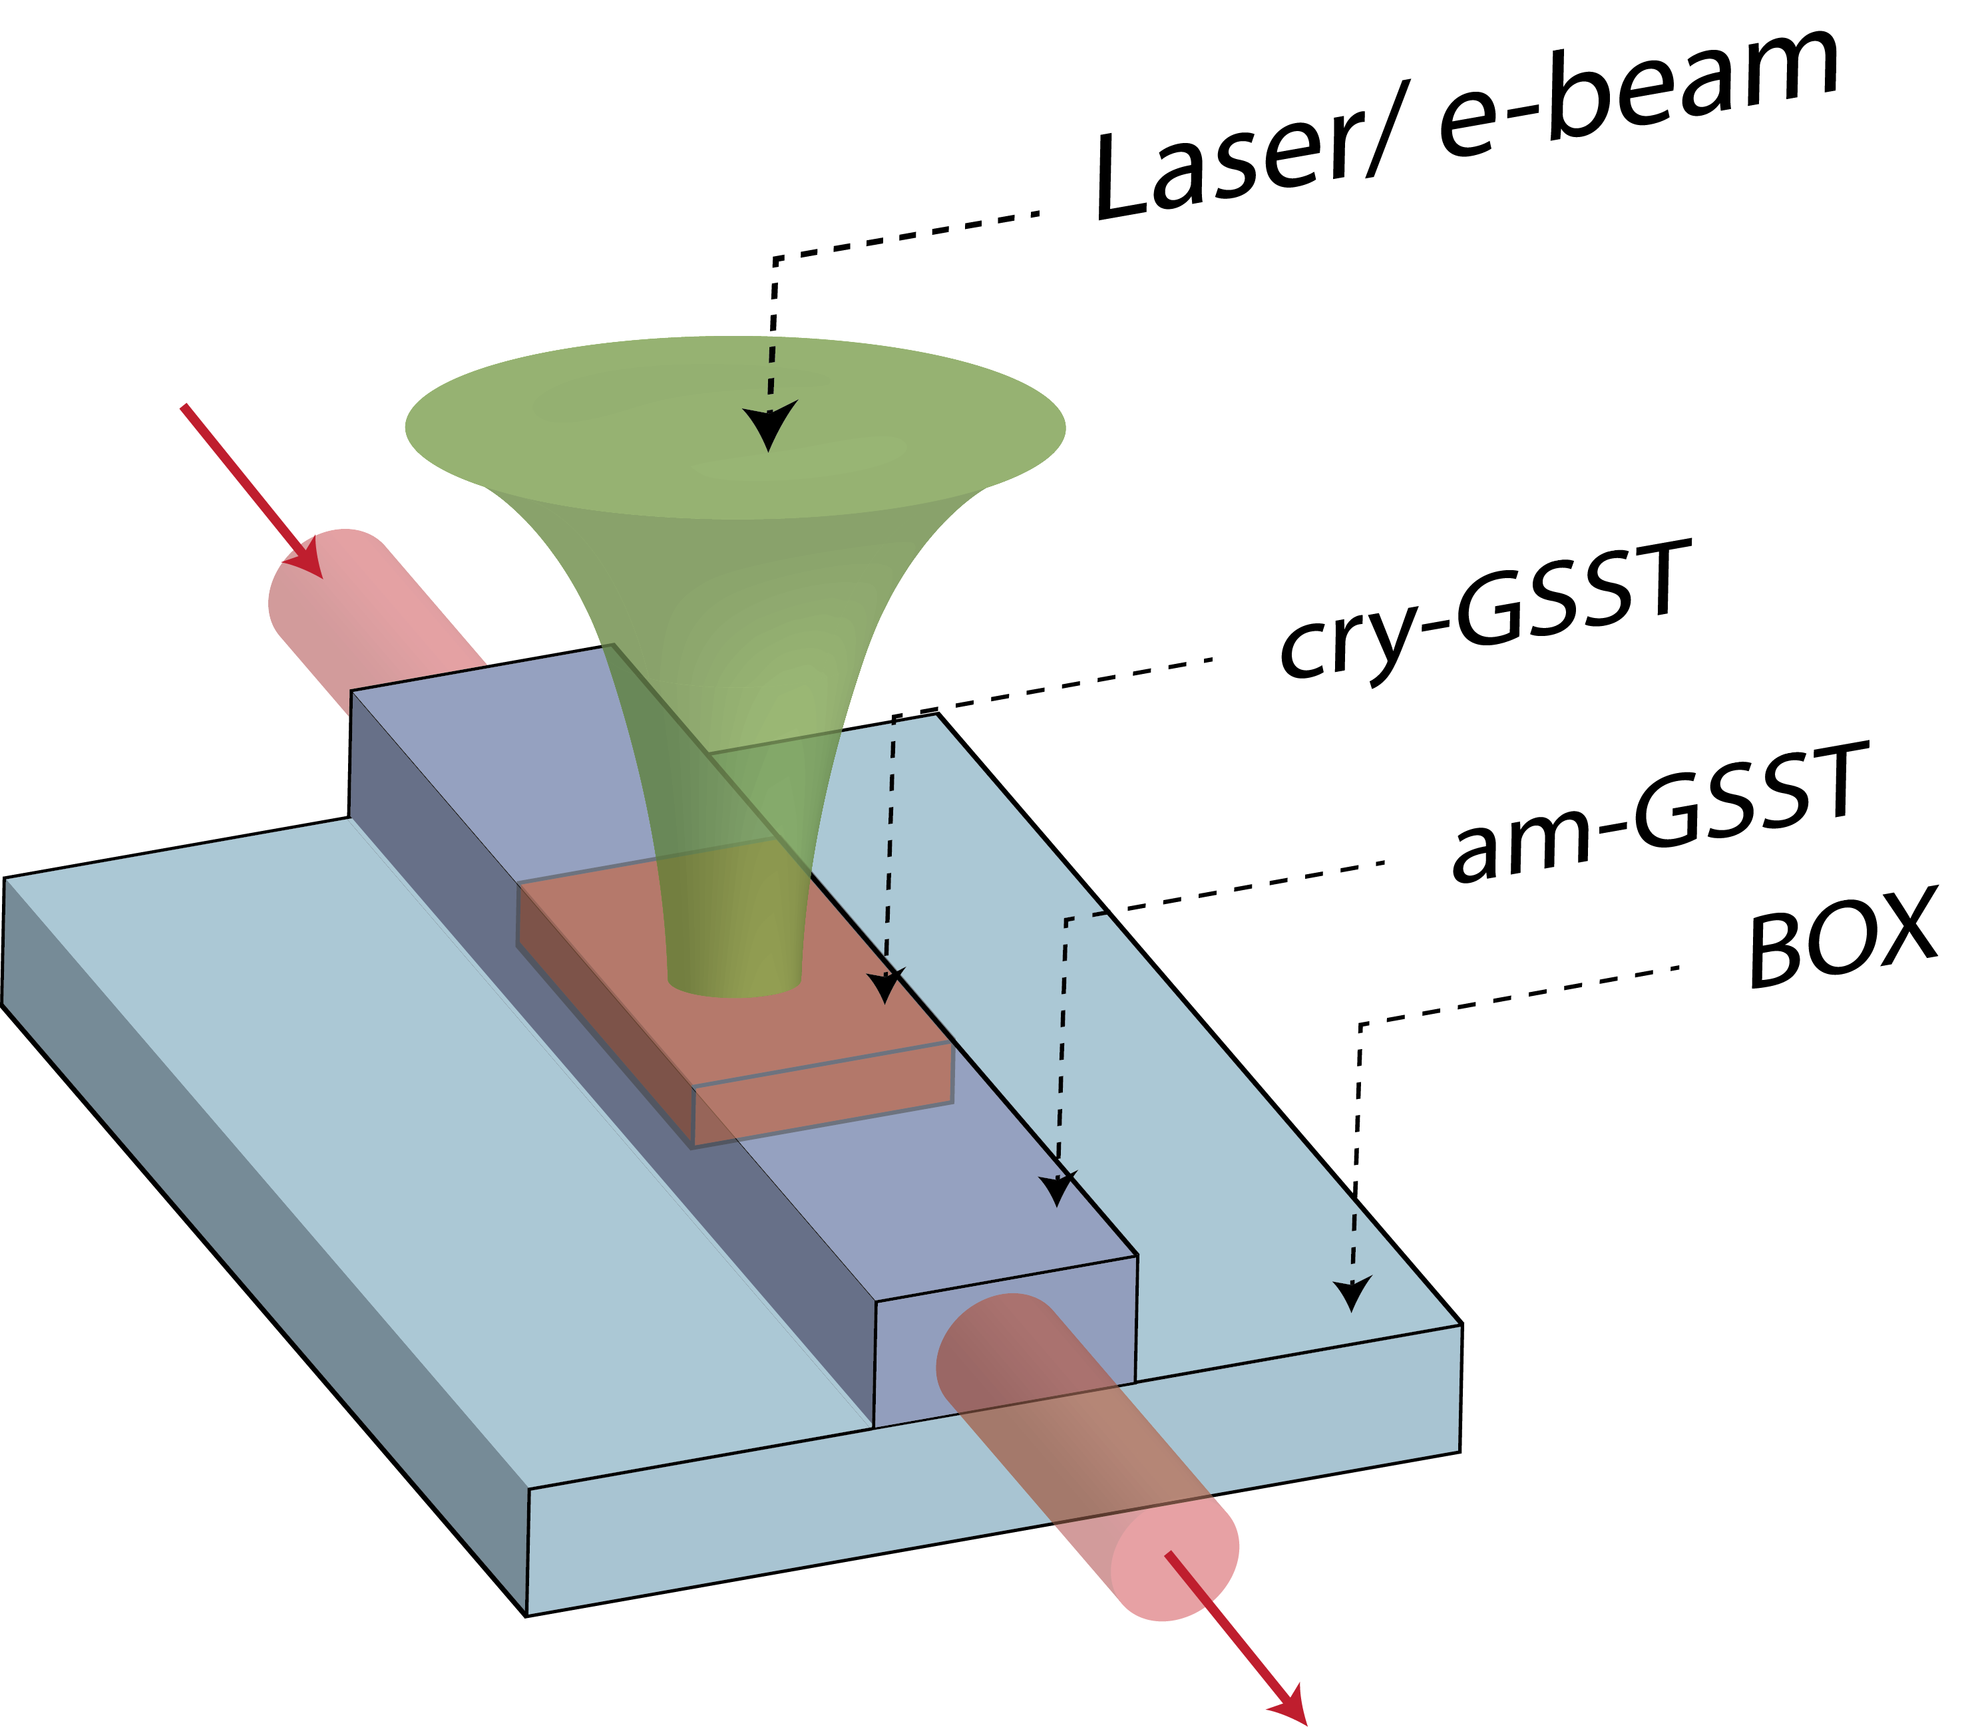
Motivation
Why Ge₂Sb₂Se₄Te on SiO₂?
Challenges:
Traditional Photonic Platforms (Silicon, Si₃N₄):
Volatile: Require continuous external stimulus
Weak refractive index tunability post-fabrication
Requires complex processes → ion implantation
Active tunability → multiple fabrication steps
Polymer based PICs (PMMA, PC, PS):
Poor fabrication precision
Poor long-term stability
Thermally unstable
No inherent post-fabrication reconfigurability
GSST on SiO₂
Solution: A monolithic PCM platform
Non-volatile reconfigurability → energy efficient
Strong post-fabrication tuning and programmability
Monolithic integration of active and passive functions
Simple fabrication steps
5

Slide 3
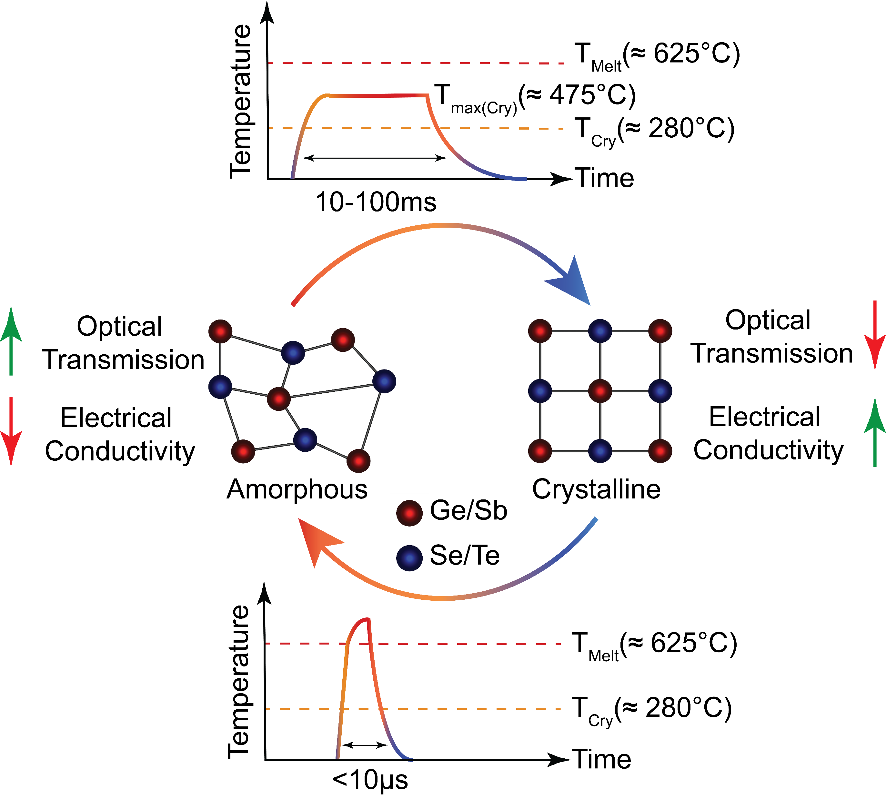
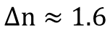
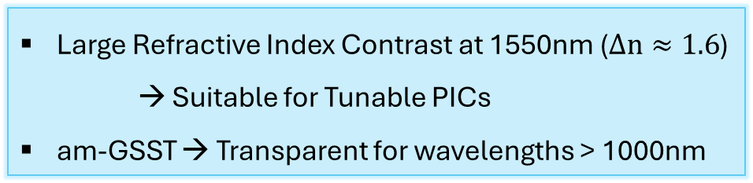
Material Selection
Ge₂Sb₂Se₄Te: A broadband, slow, phase change material
5
n_{am}
k_{am}
GSST on SiO₂
n_{cry}
4
k_{cry}
n, k
3
2
1
0
200
400
600
800
1000
1200
1400
1600
Wavelength (nm)
6

Slide 4
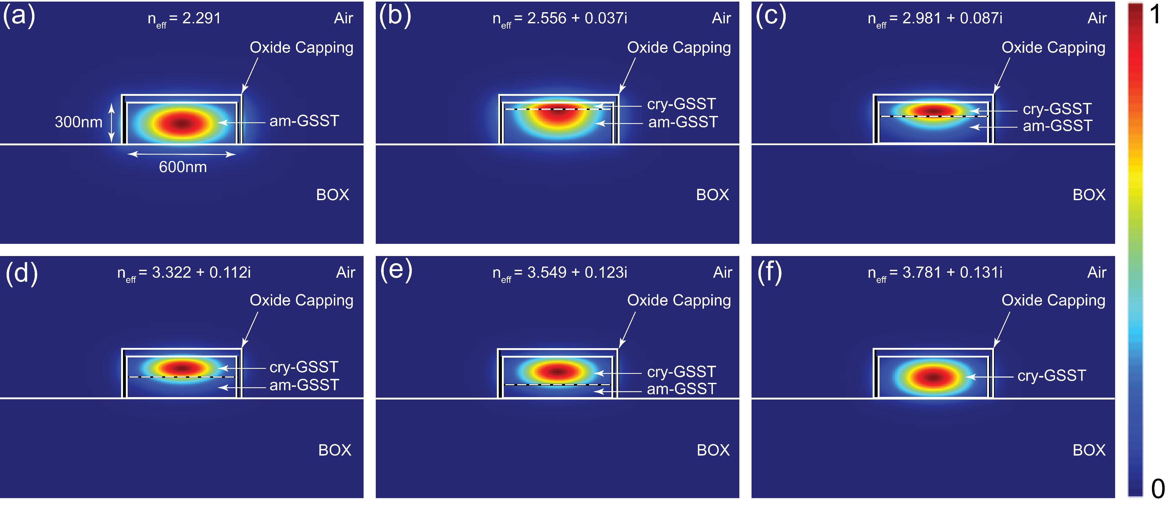
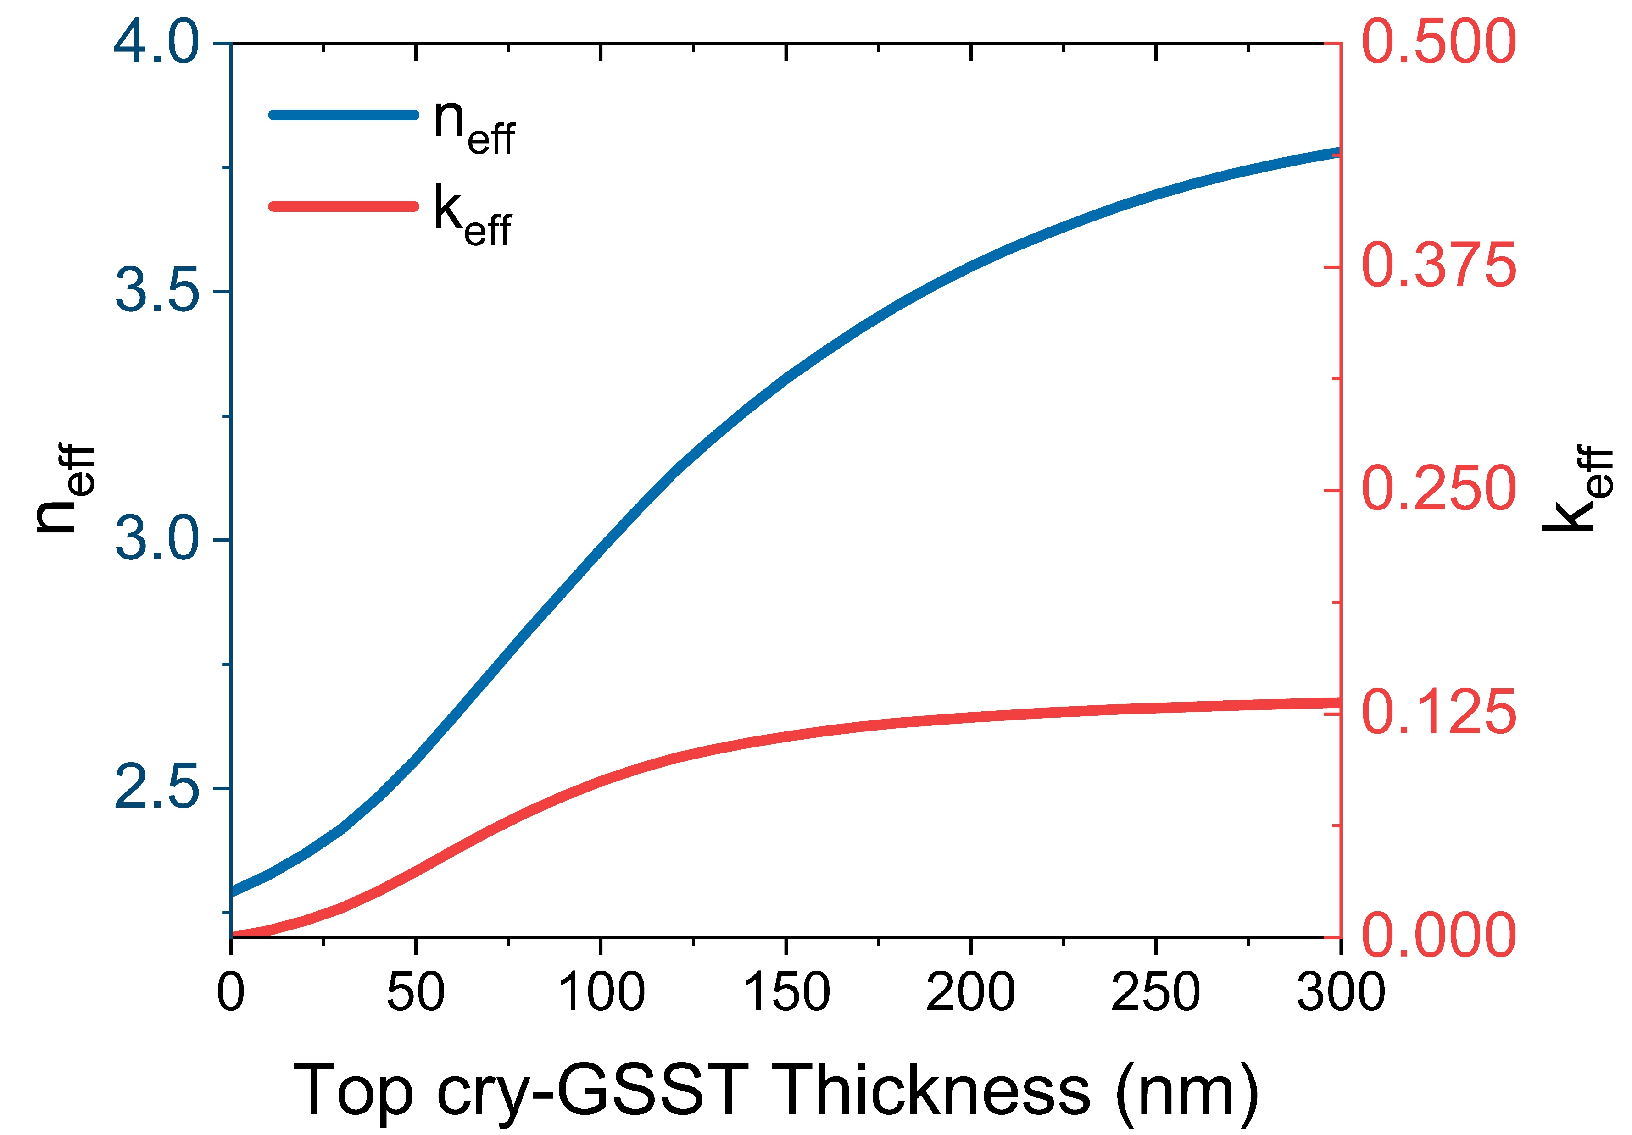
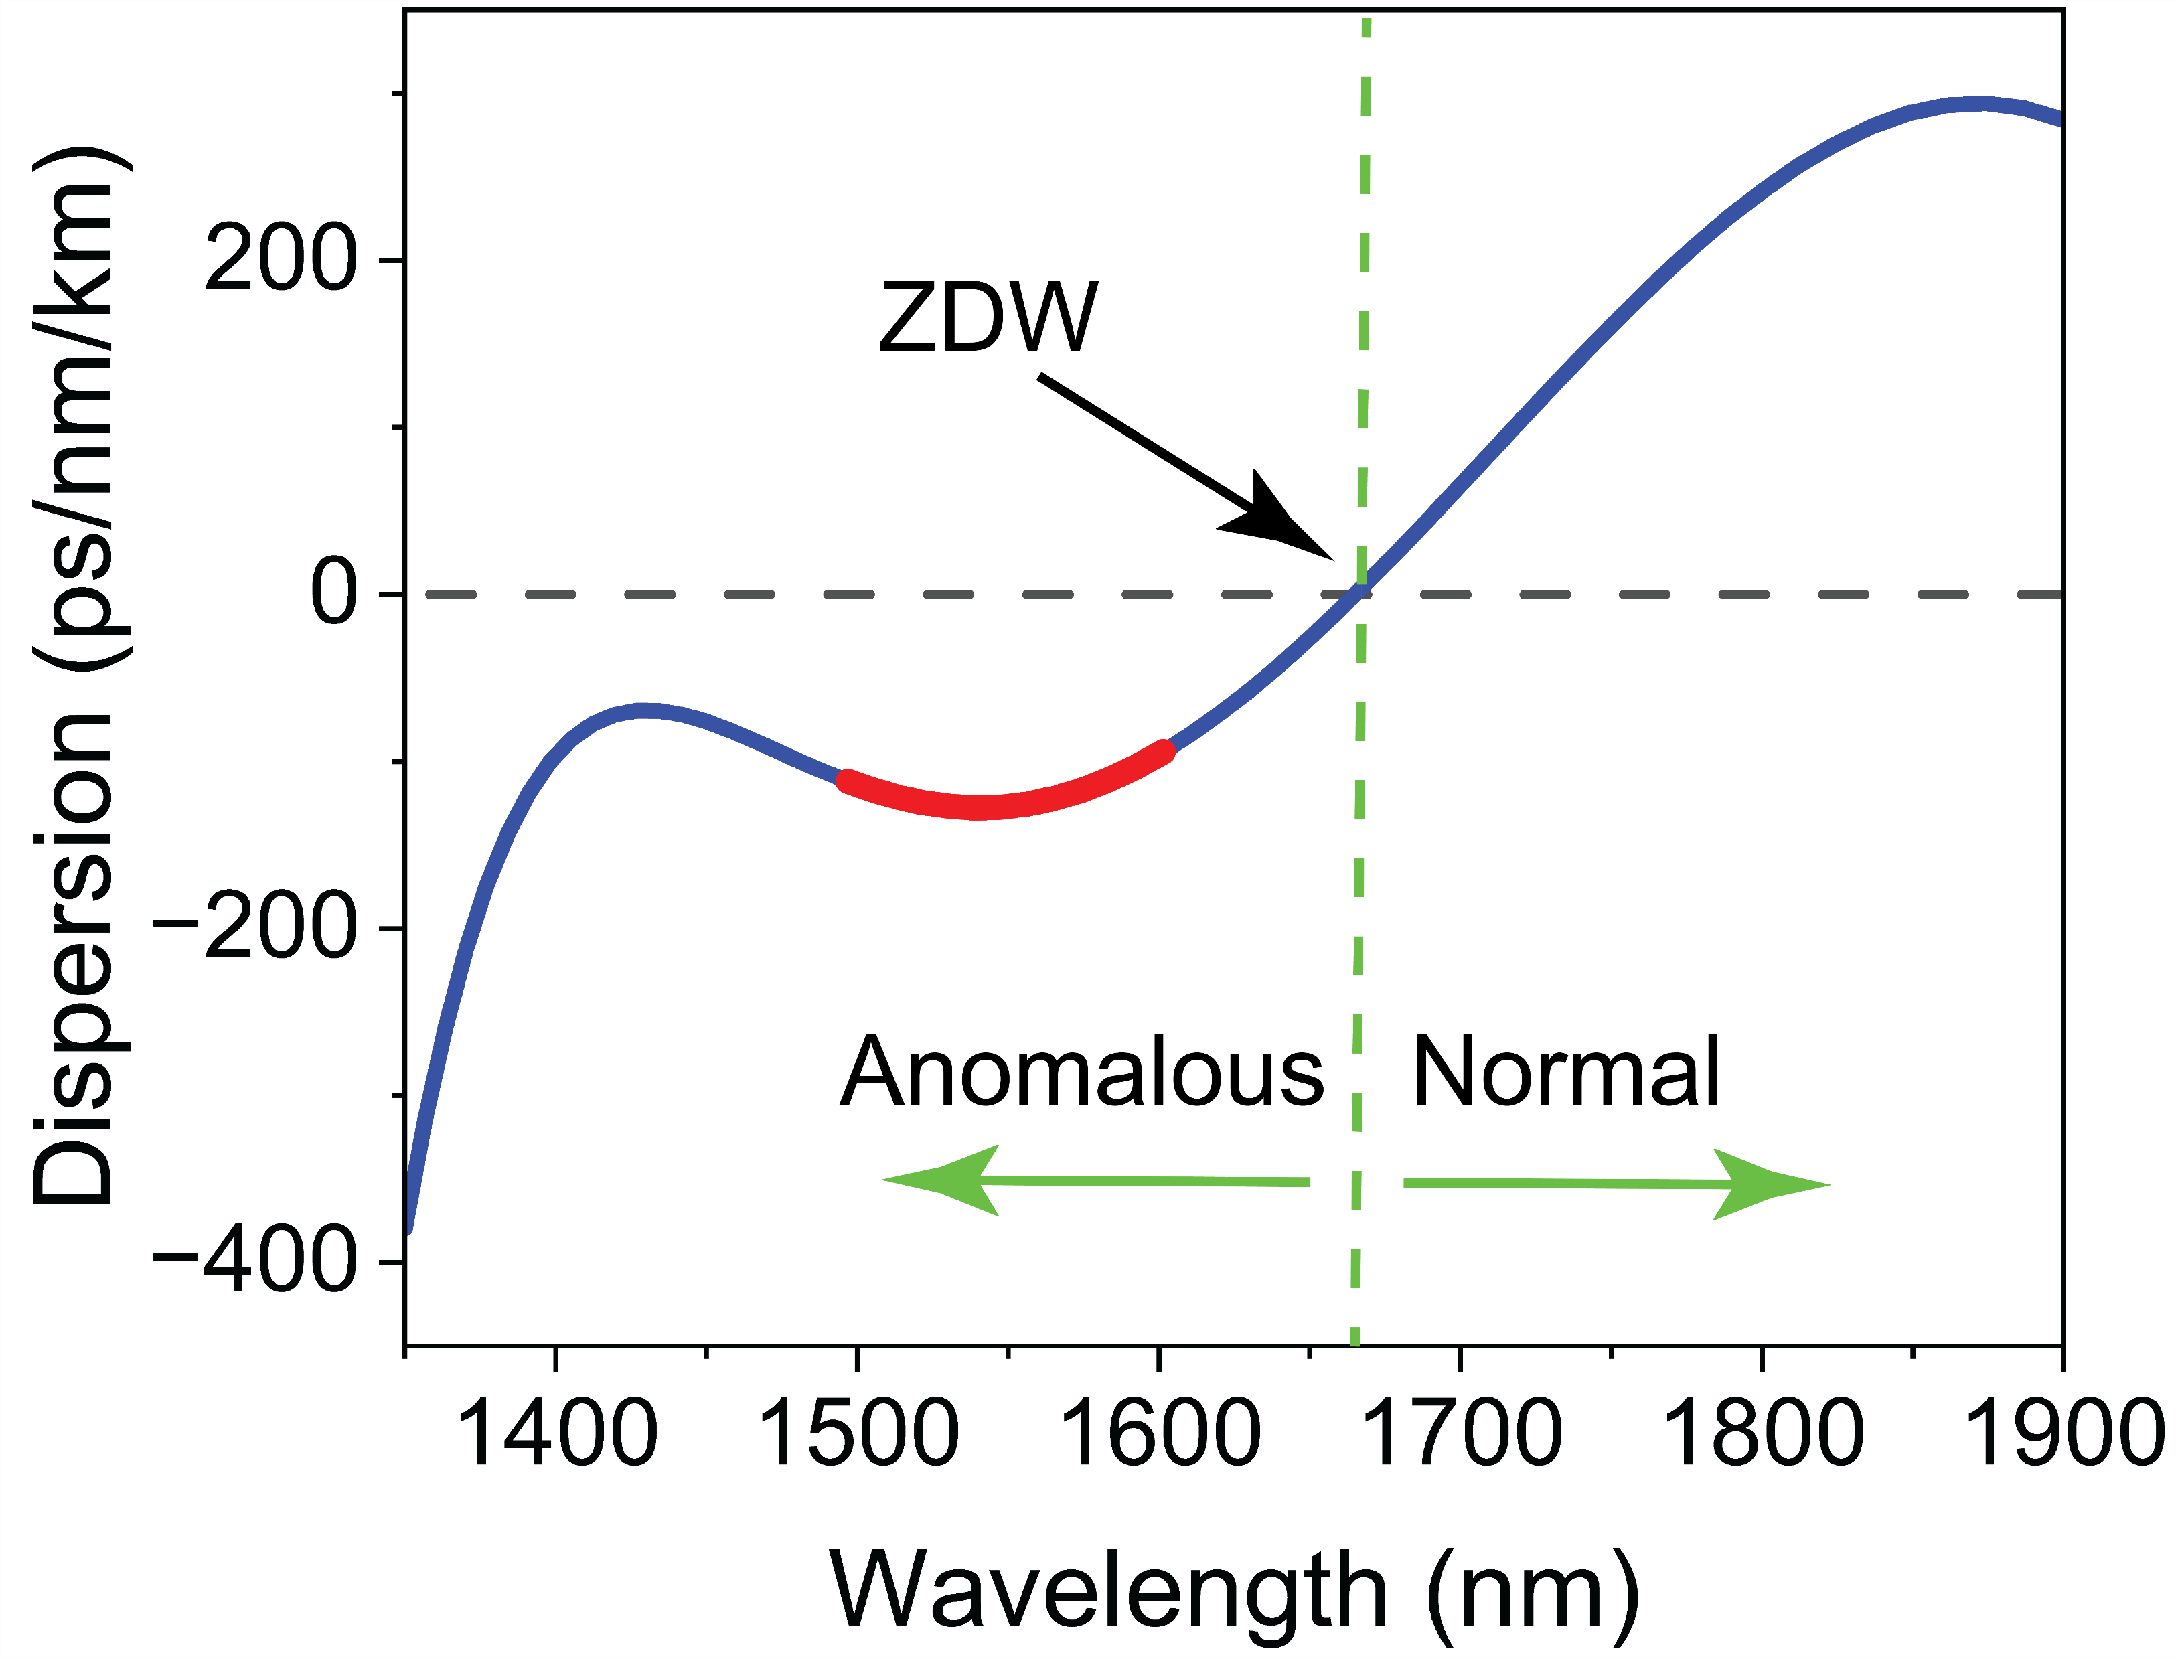
Simulation
Mode Simulation (Lumerical MODE)
GSST on SiO₂
300nm am-GSST, (b) 50nm cry-GSST, (c) 100nm cry-GSST,
(d) 150nm cry-GSST, (e) 200nm cry-GSST, (f) 300nm cry-GSST
ZDW: Minimal Dispersion→ 1660nm
Tailoring Material & Waveguide Geometry: ZDW → 1550nm
1540nm → Most negative anomalous dispersion (1500nm-1600nm)
Can Support most stable, tightly confined Solitons
1660nm
1540nm
7
Notes:
1540 nm is the optimal wavelength for soliton formation in your material because the anomalous dispersion is strongest there, maximizing the nonlinear-dispersive balance needed for soliton and SCG phenomena

Slide 5
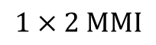
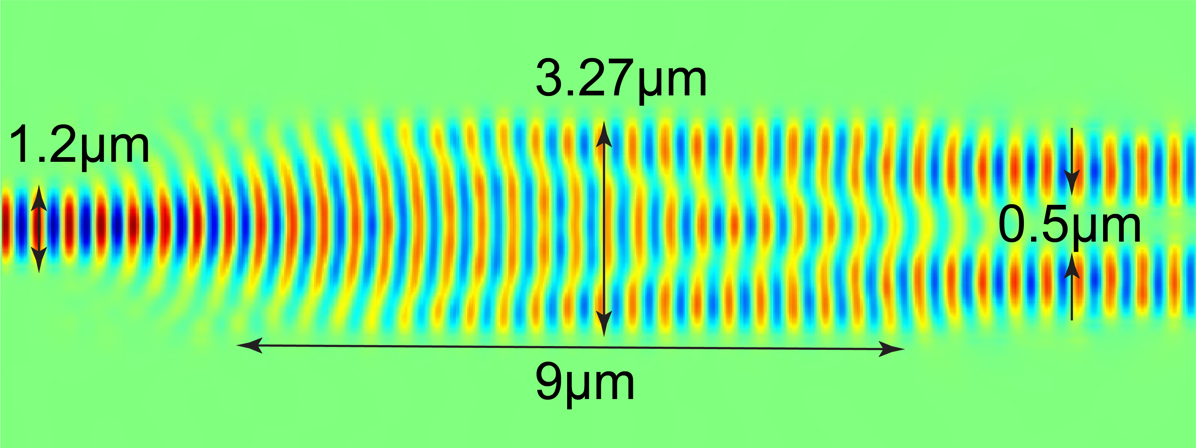
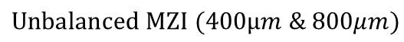
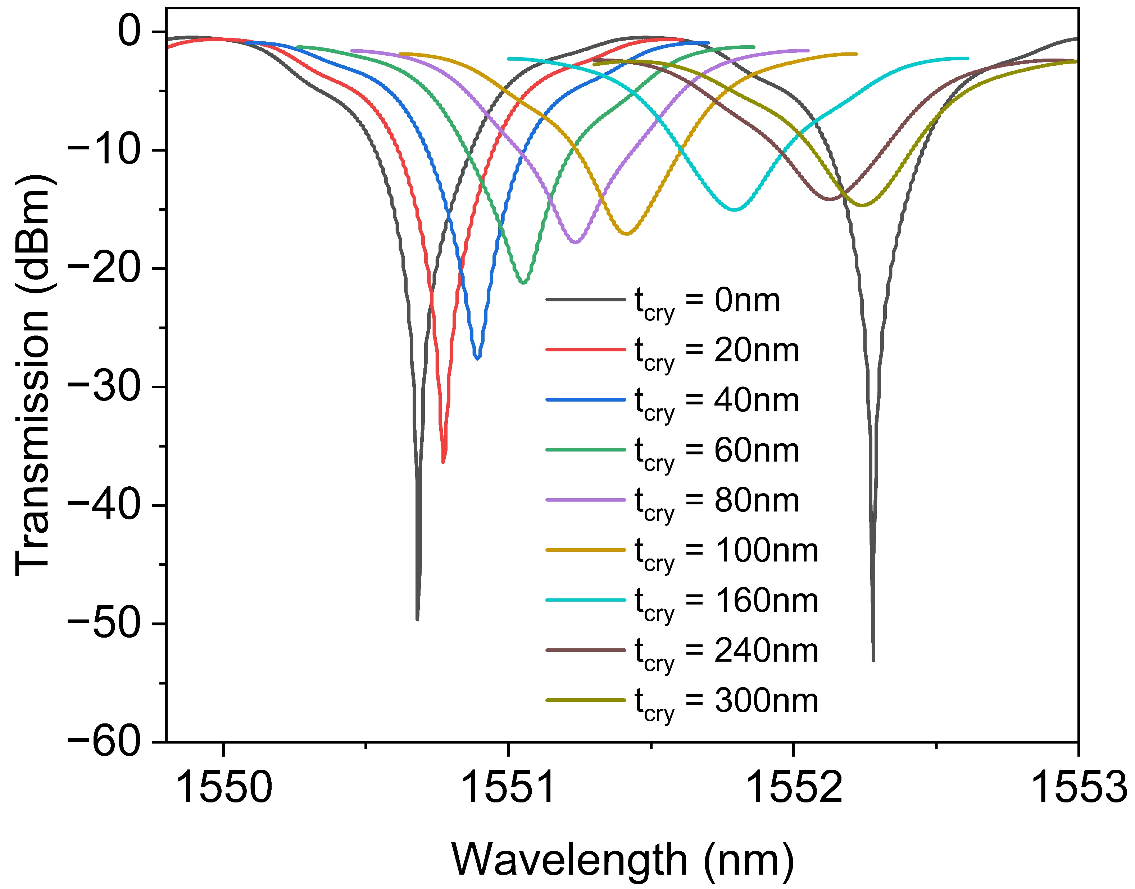
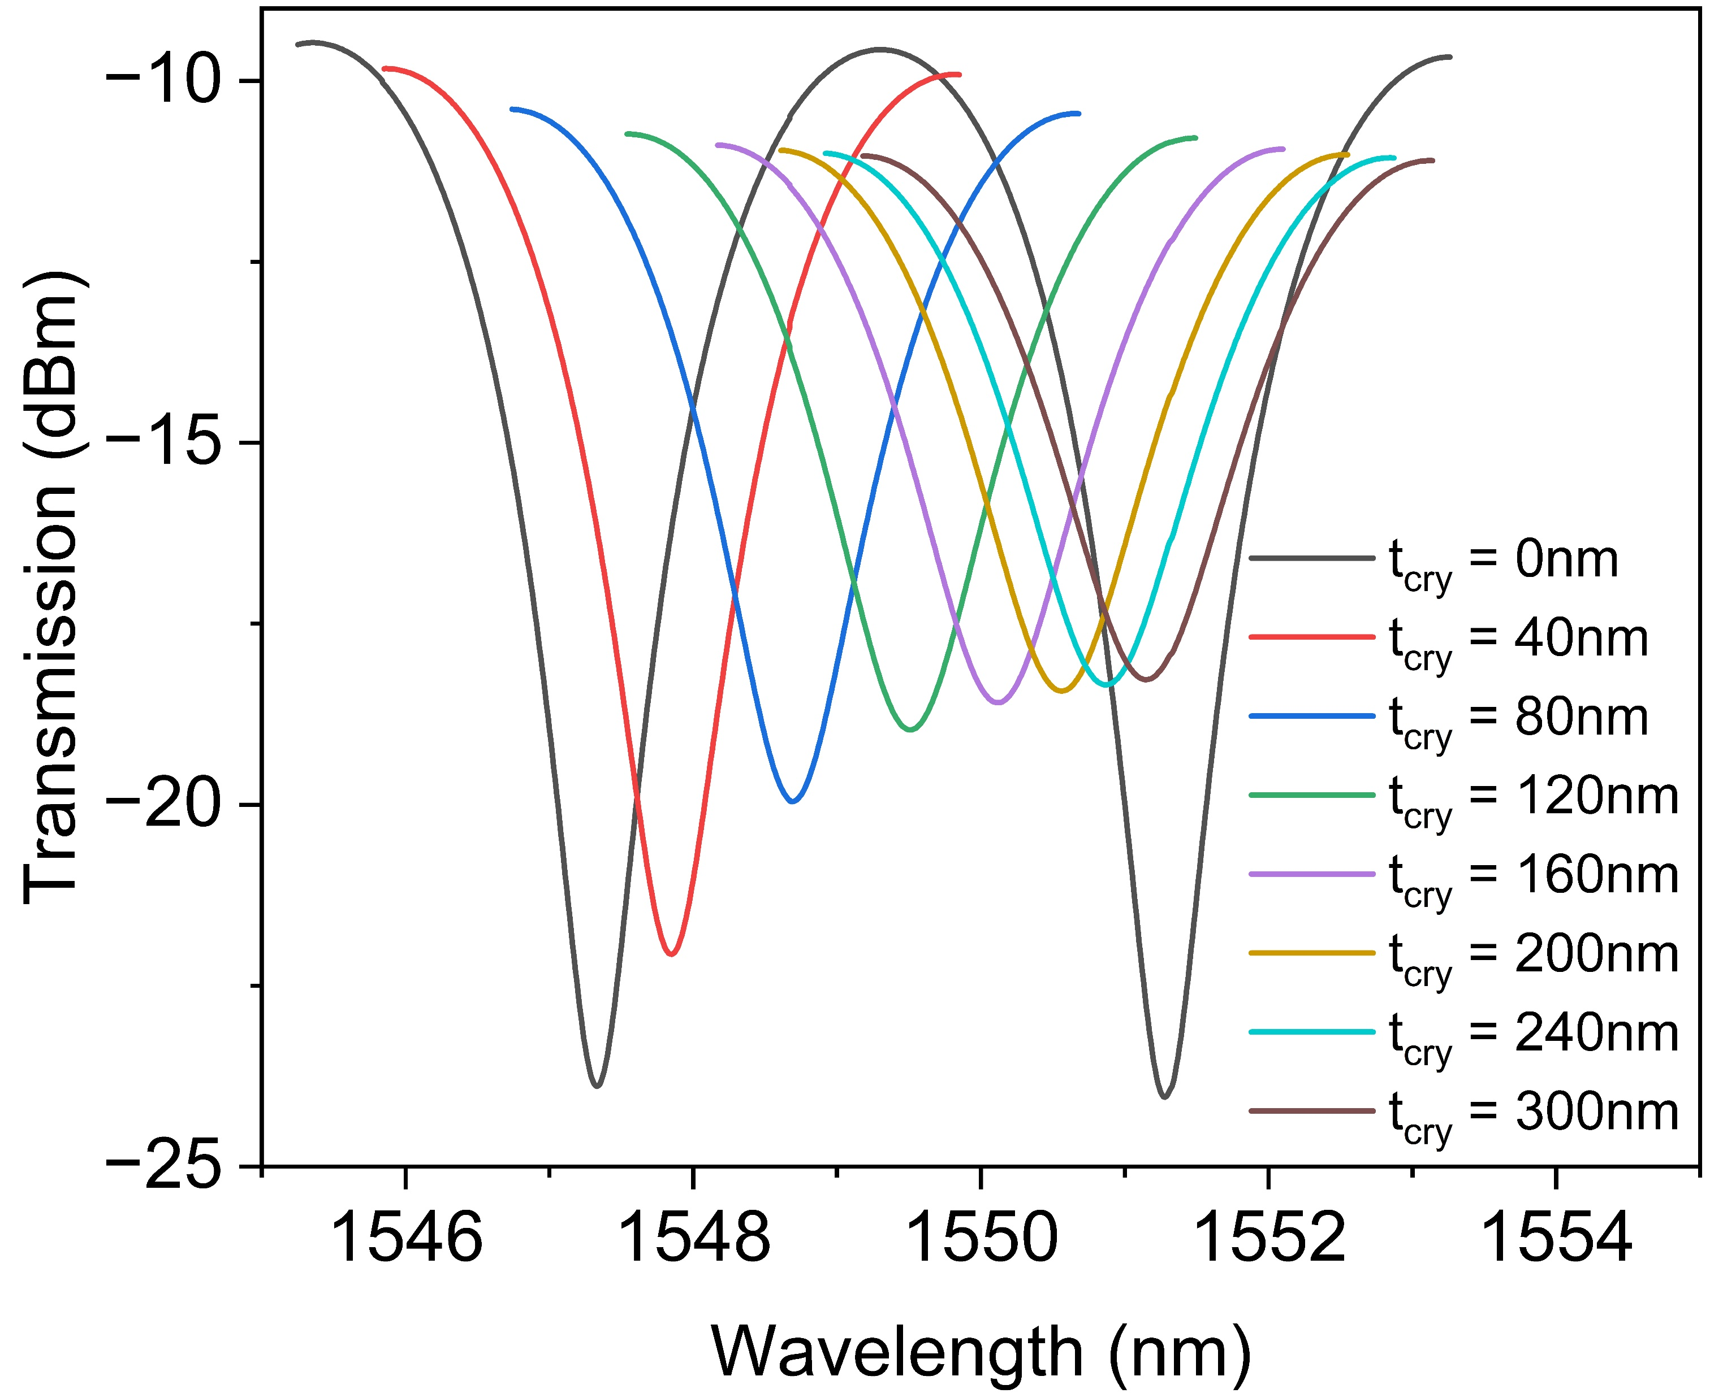
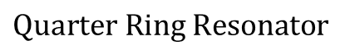
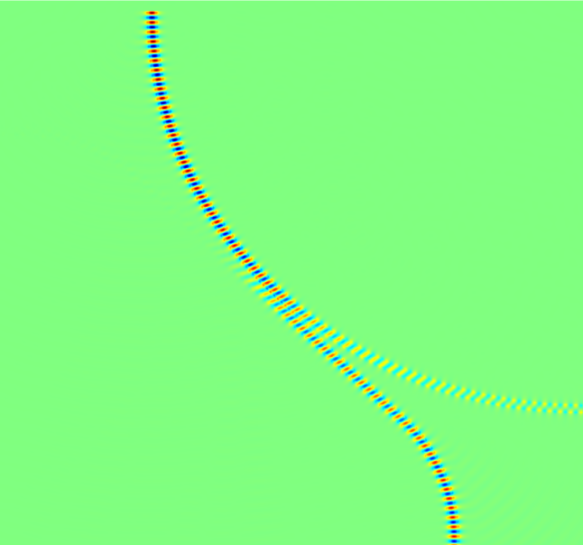
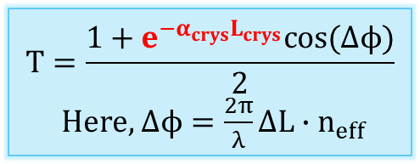
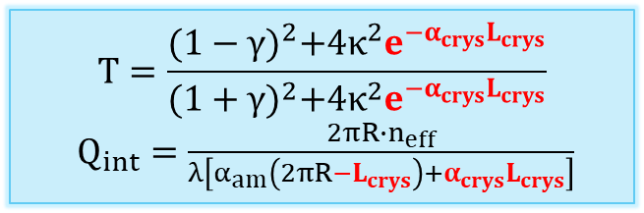
Simulation
Device & Photonic Circuit Simulation (Lumerical FDTD & Interconnect)
Particle Swarm Optimization (PSO)
Post-Fab Tuning Simulation
GSST on SiO₂
Ey
Ex
8
Notes:
Ideal vs. Realistic Mode Profiles
In FDTD simulations (especially with default or idealized settings), the waveguide modes are often tightly confined and don’t "leak" as much into the cladding.
This causes evanescent fields to decay rapidly, so you need very small gaps (like <30 nm) to get any noticeable coupling.
Reality check: In fabricated devices, imperfections (e.g. sidewall roughness, cladding variations, index gradients) often increase the mode size or cause more field overlap, boosting coupling even at larger gaps

Slide 6
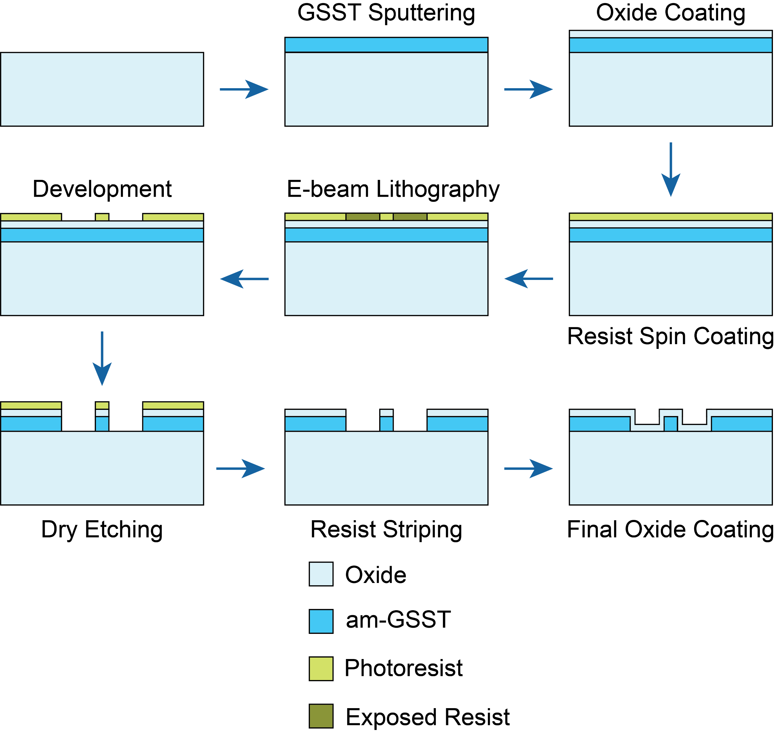
Fabrication
Fabrication Steps
GSST on SiO₂
Challenges and Solutions:
Strong adhesion between positive resist and am-GSST → 50nm Oxide Coating
Weak Adhesion between Resist and Oxide Coating → HMDS
Charge Accumulation due to Oxide Substrate → AquaSave
Oxidation of am-GSST over time→ Final 20nm Oxide Coating
9

Slide 7
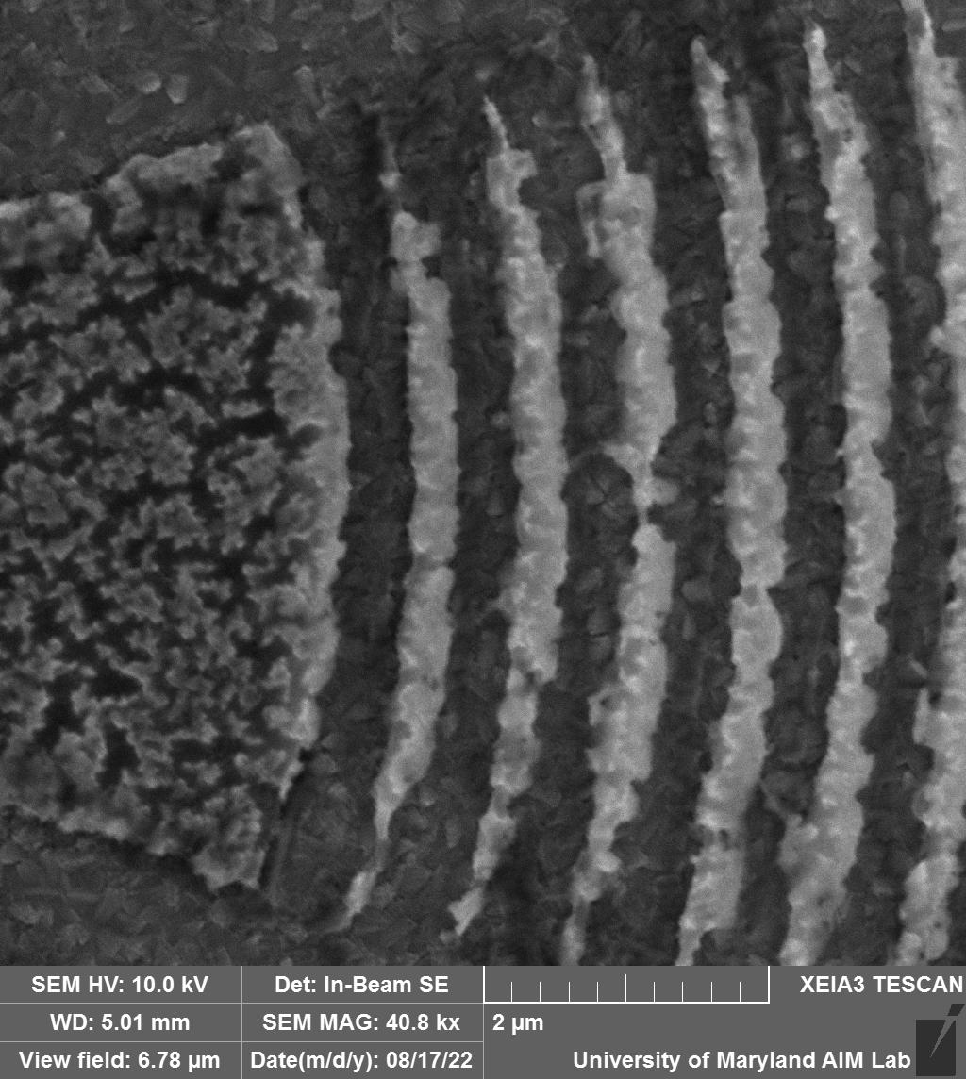
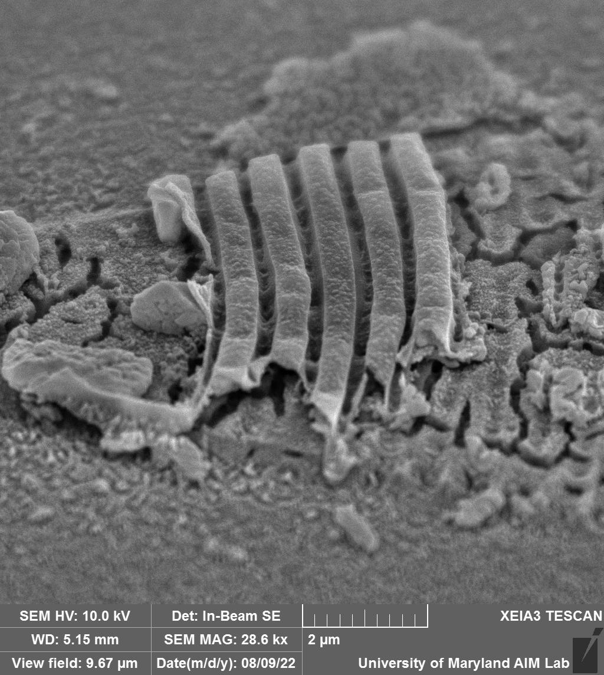
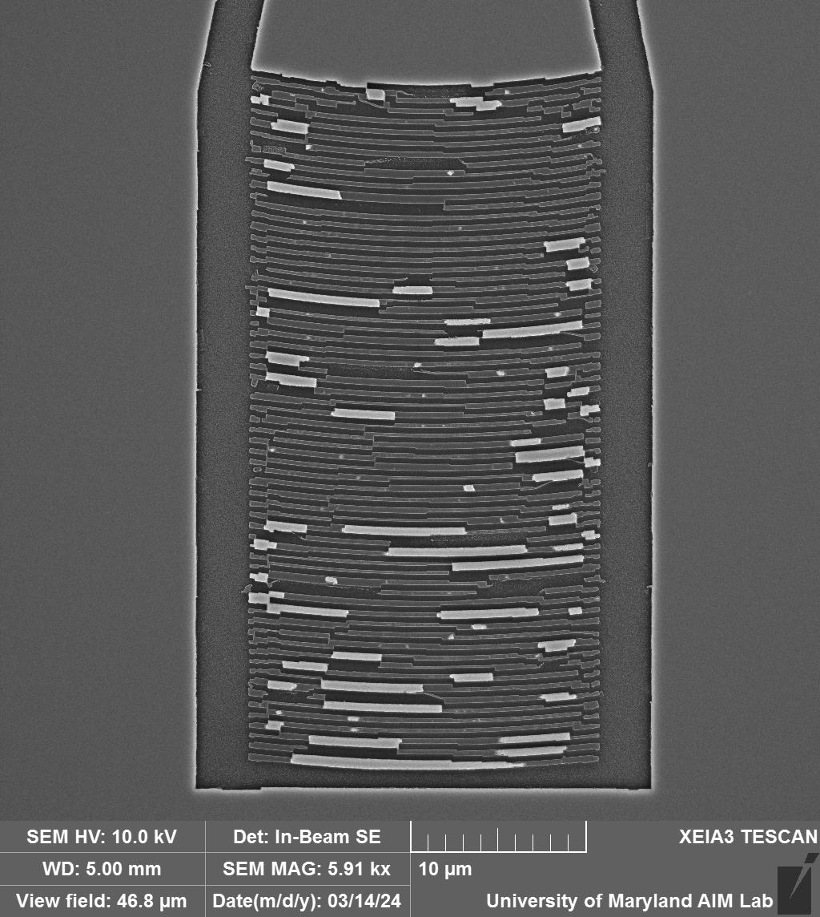
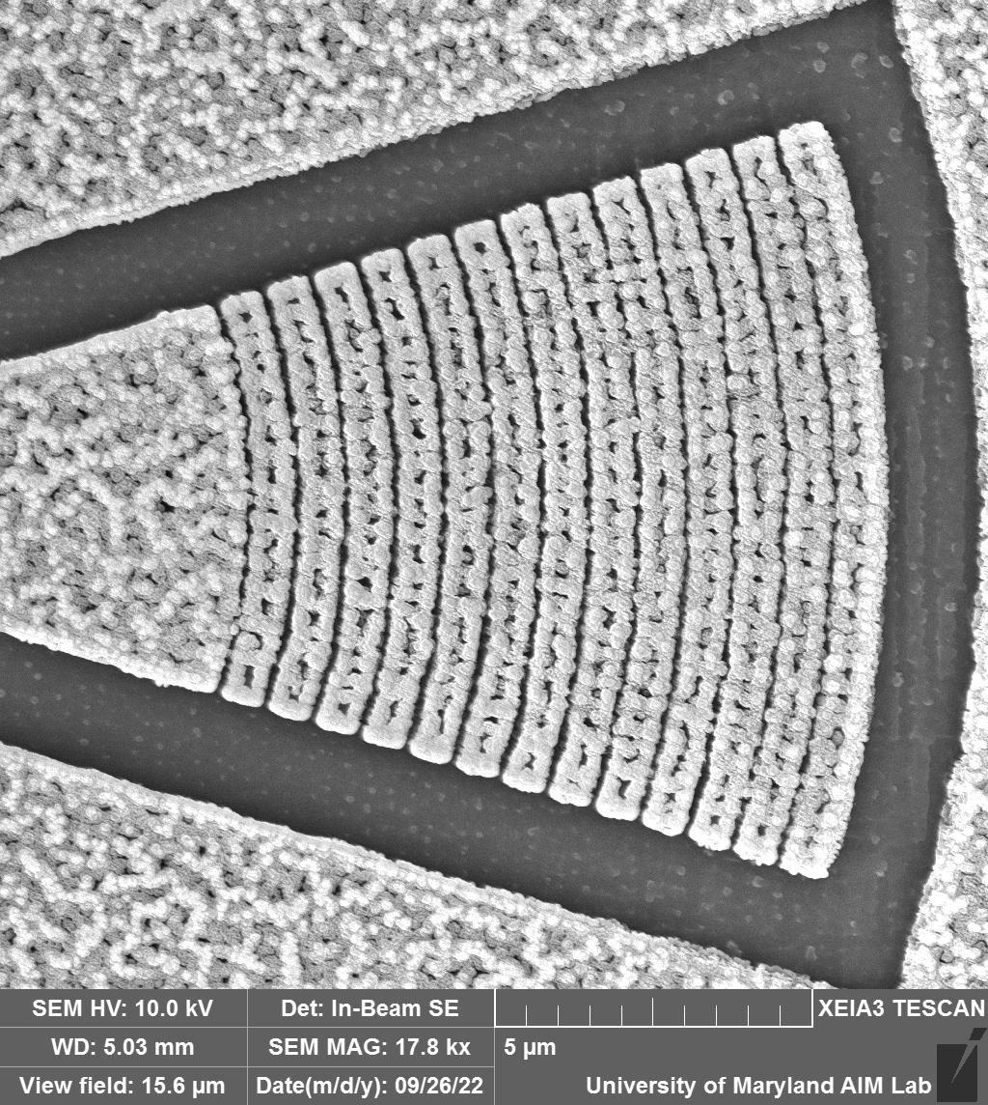
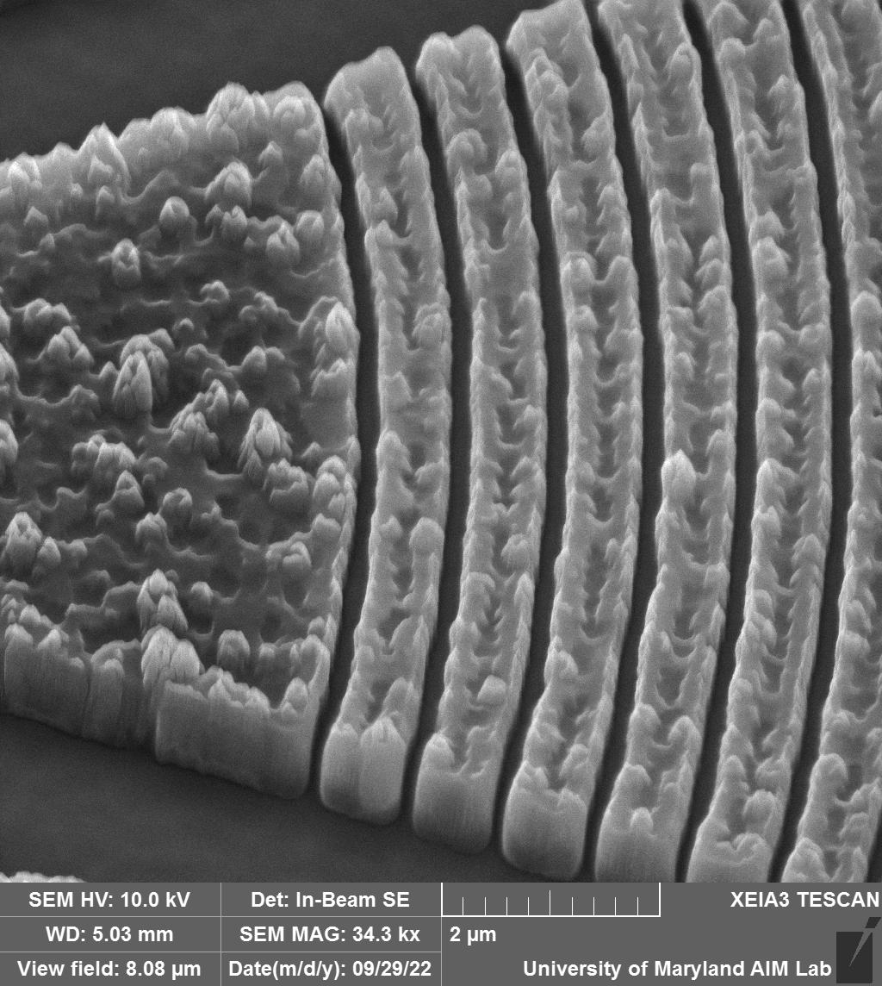
Fabrication
Fabricated Devices (Before)
GSST on SiO₂
10

Slide 8
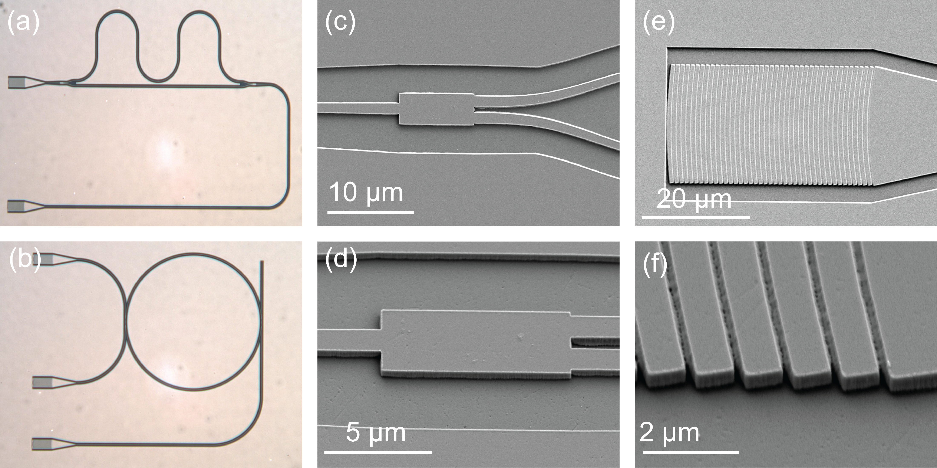
Fabrication
Fabricated Devices (After)
GSST on SiO₂
11

Slide 9
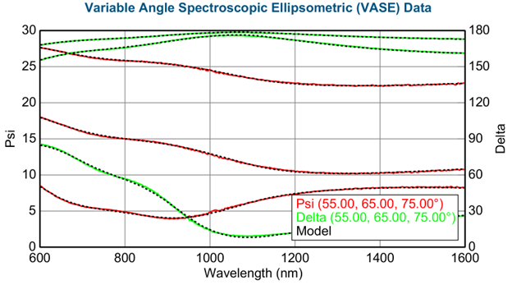
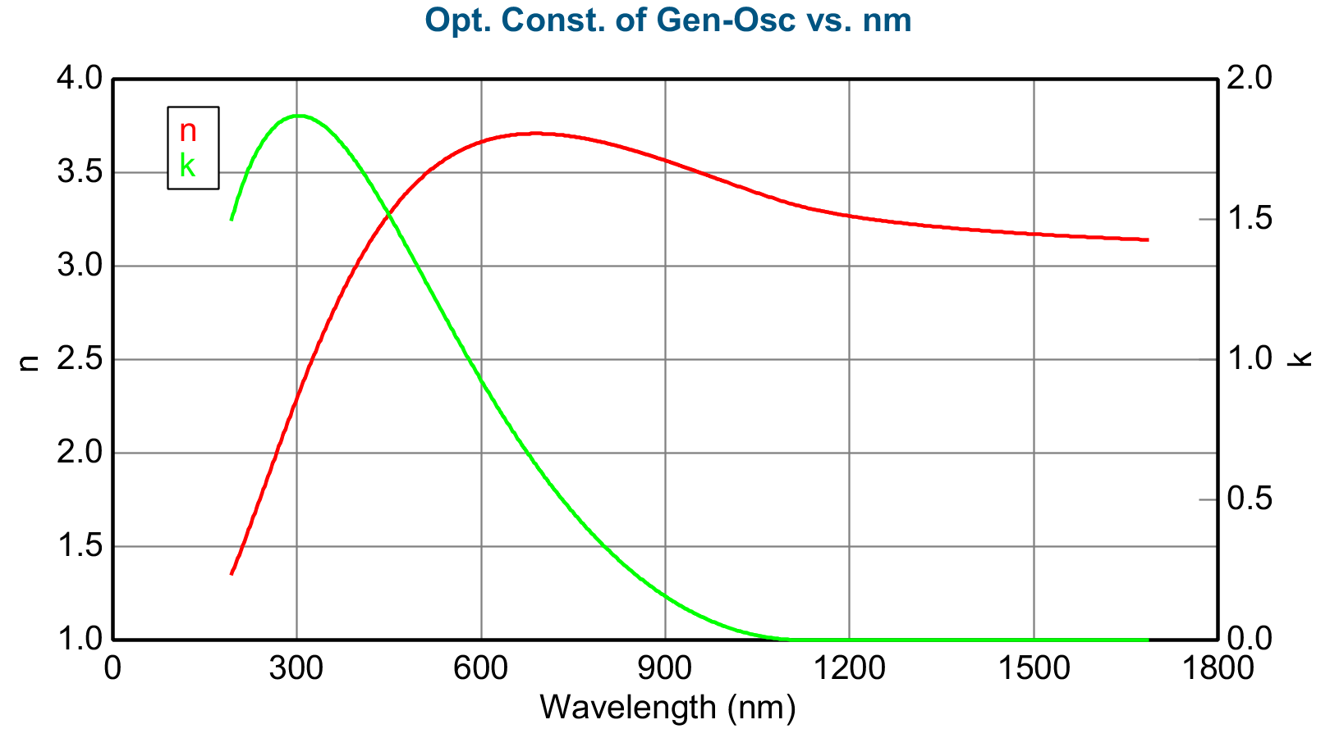
Characterization
am-GSST Material Characterization (Ellipsometry)
GSST on SiO₂
Mean Squared Error (MSE) ≈ 5
Model Prepared by: Yi-Siou Huang, Rios Lab
12

Slide 10
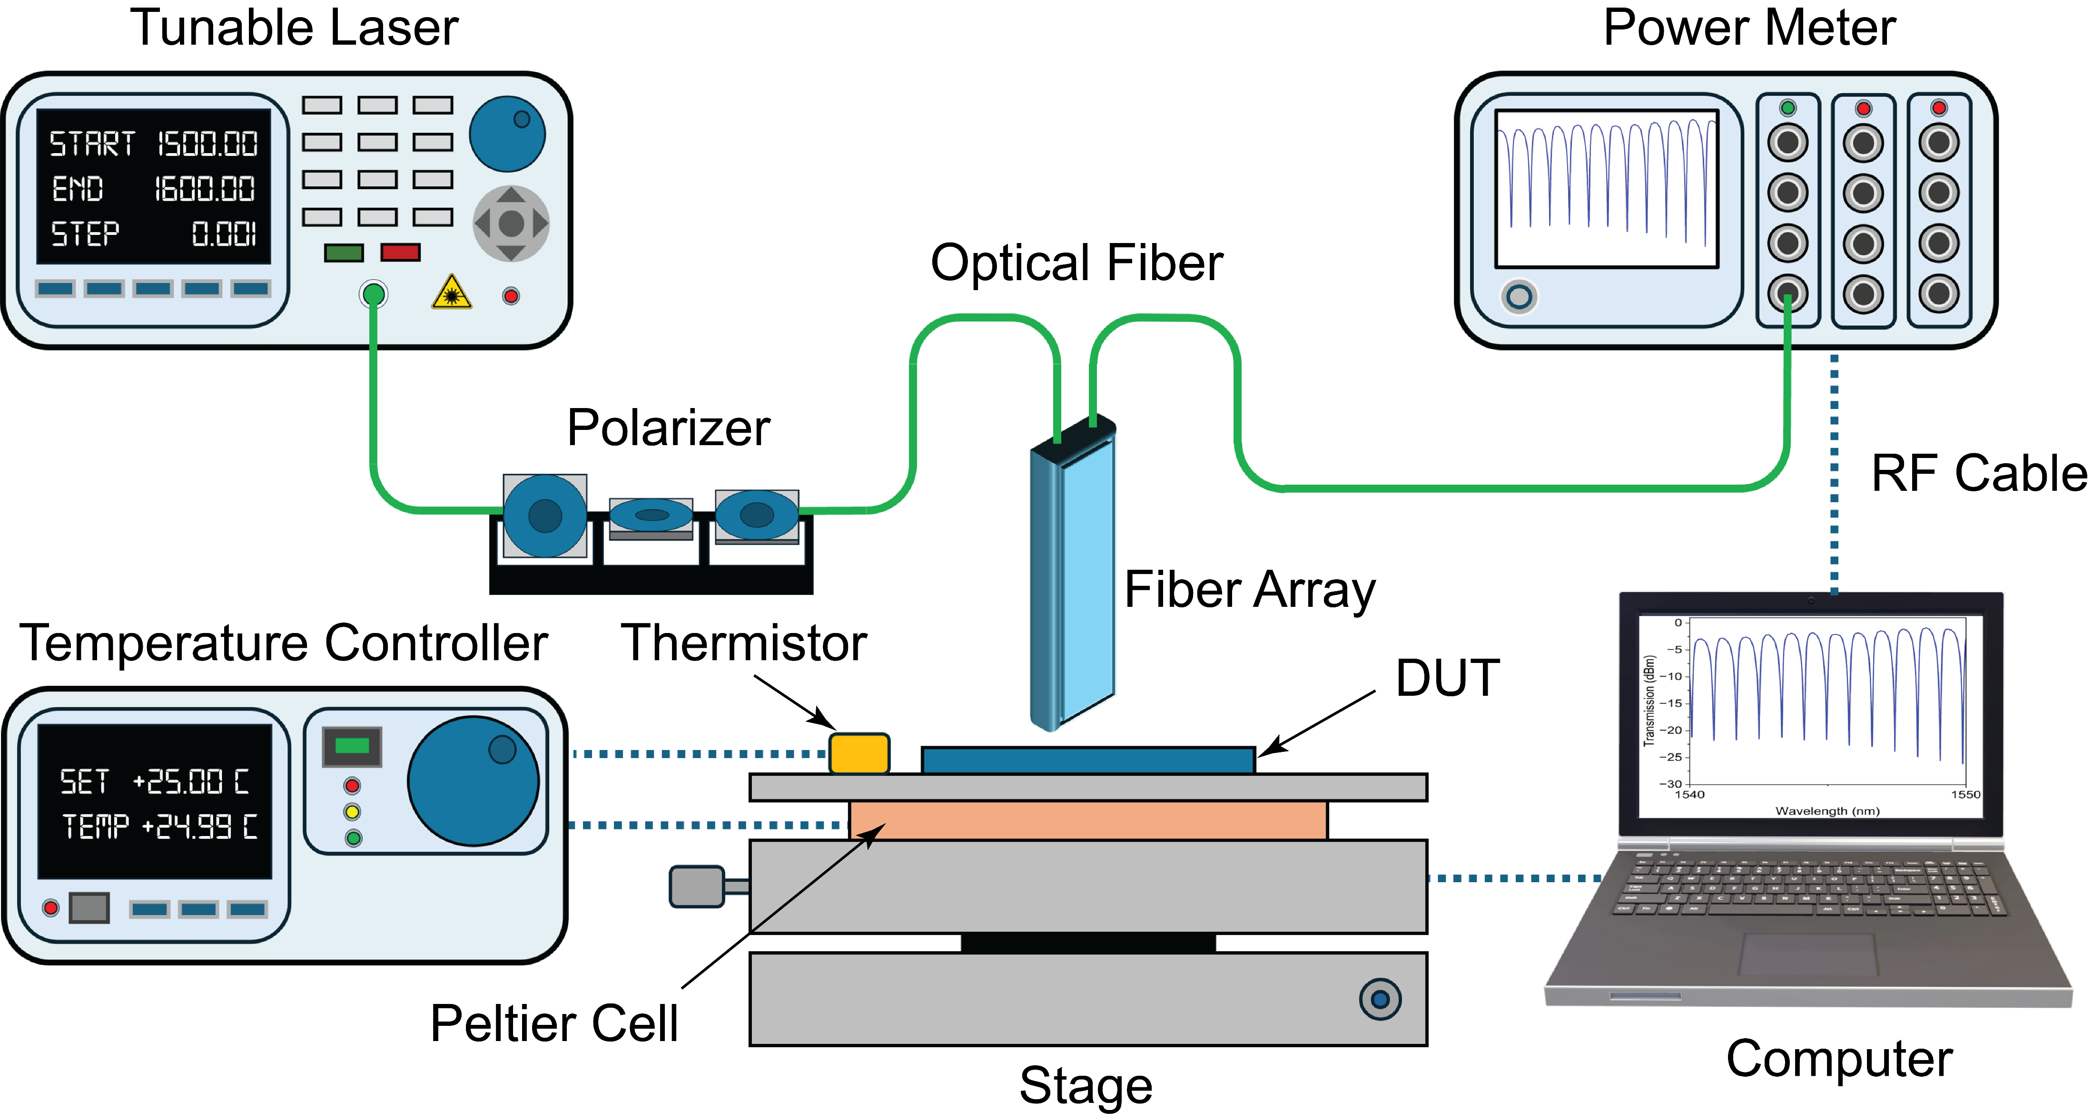
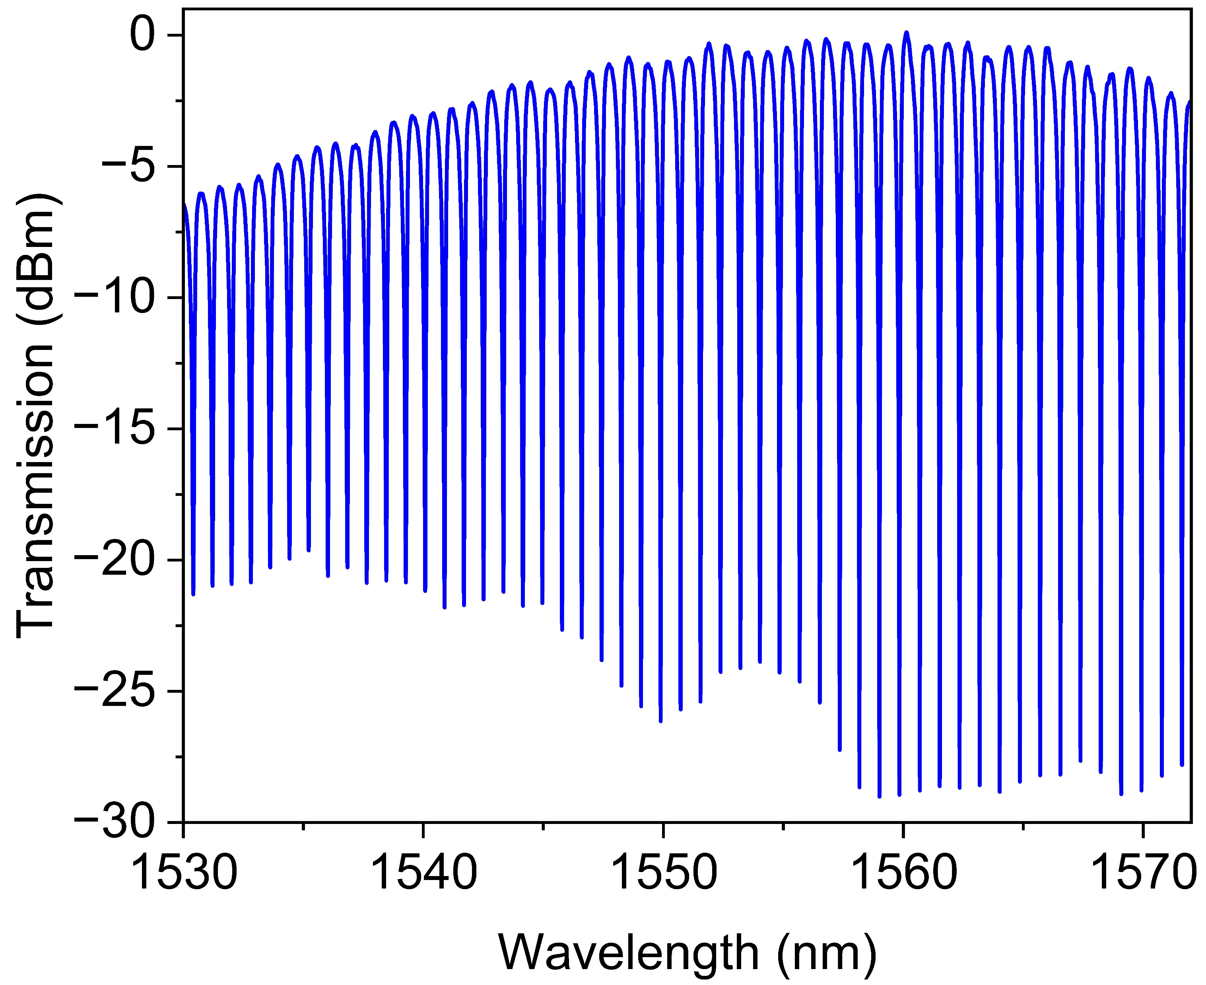
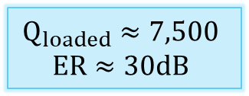
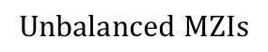
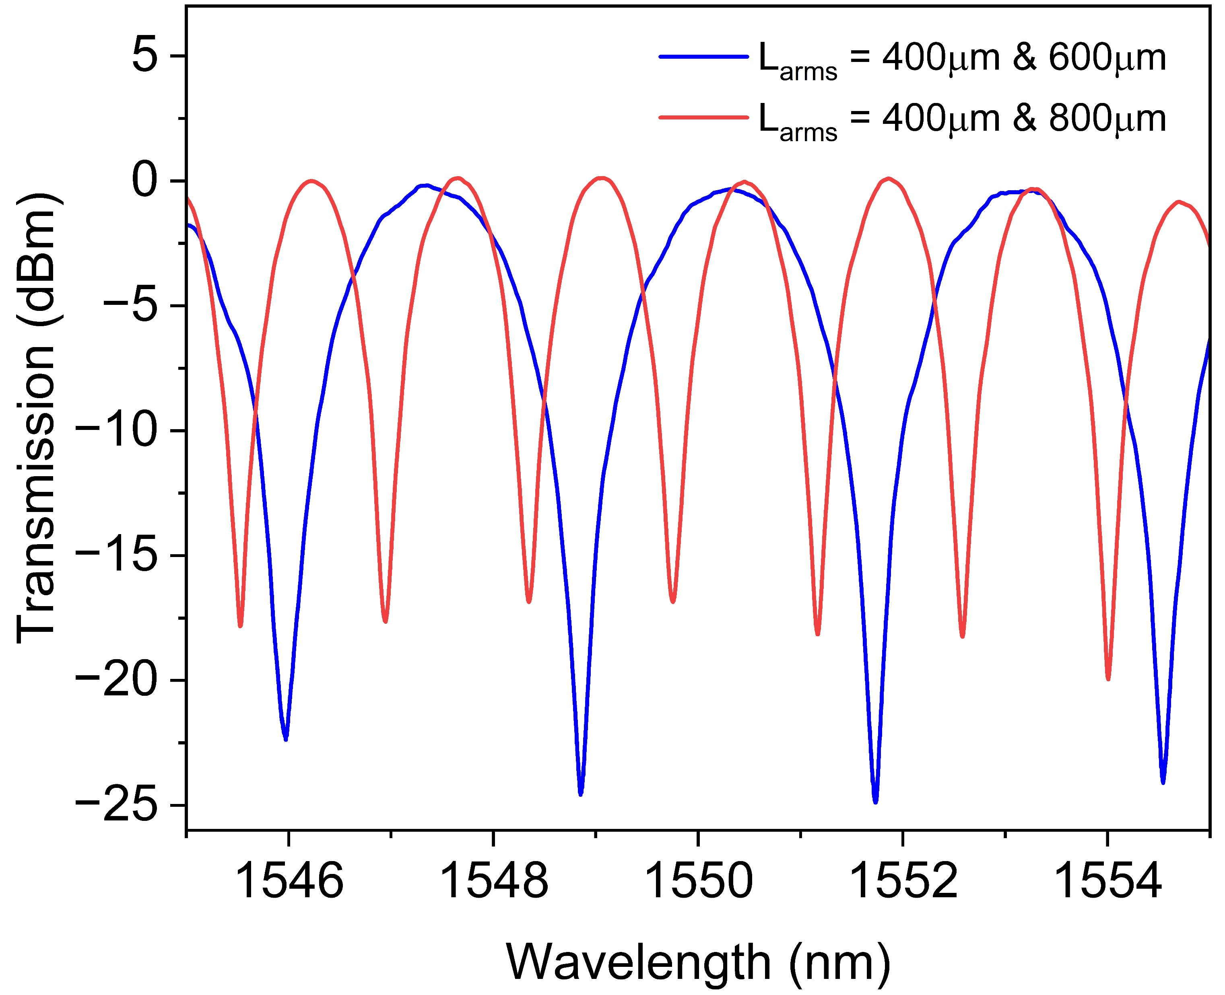
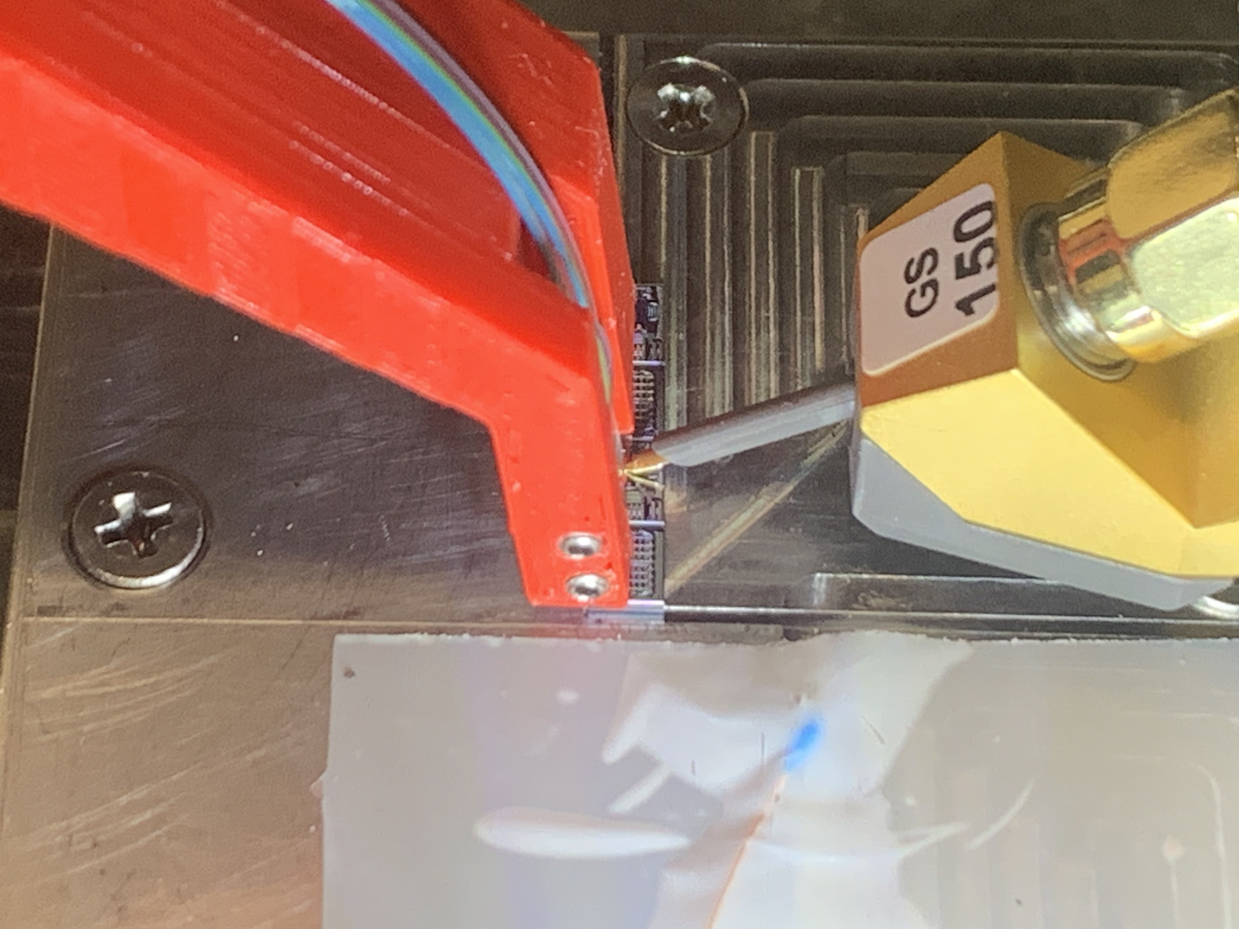
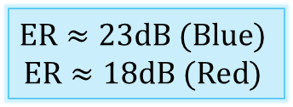
Characterization
Experimental Setup & Photonic Devices
GSST on SiO₂
Fiber Array
Electrical Probe
3D Printed Holder
DUT
Metal Stage
Thermistor
13

Slide 11
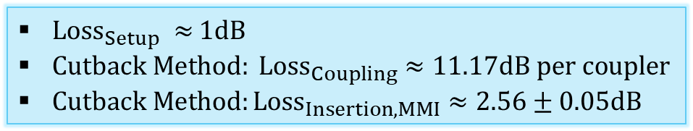
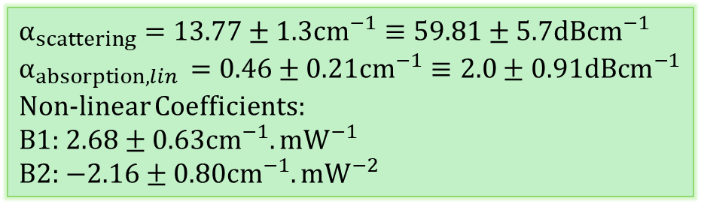
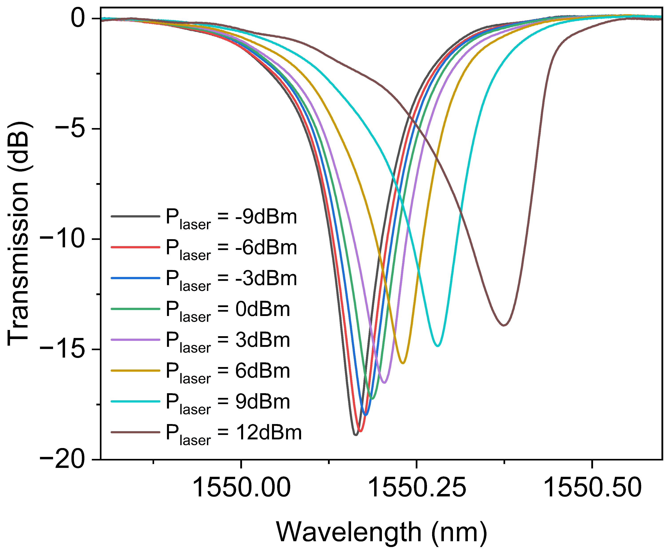
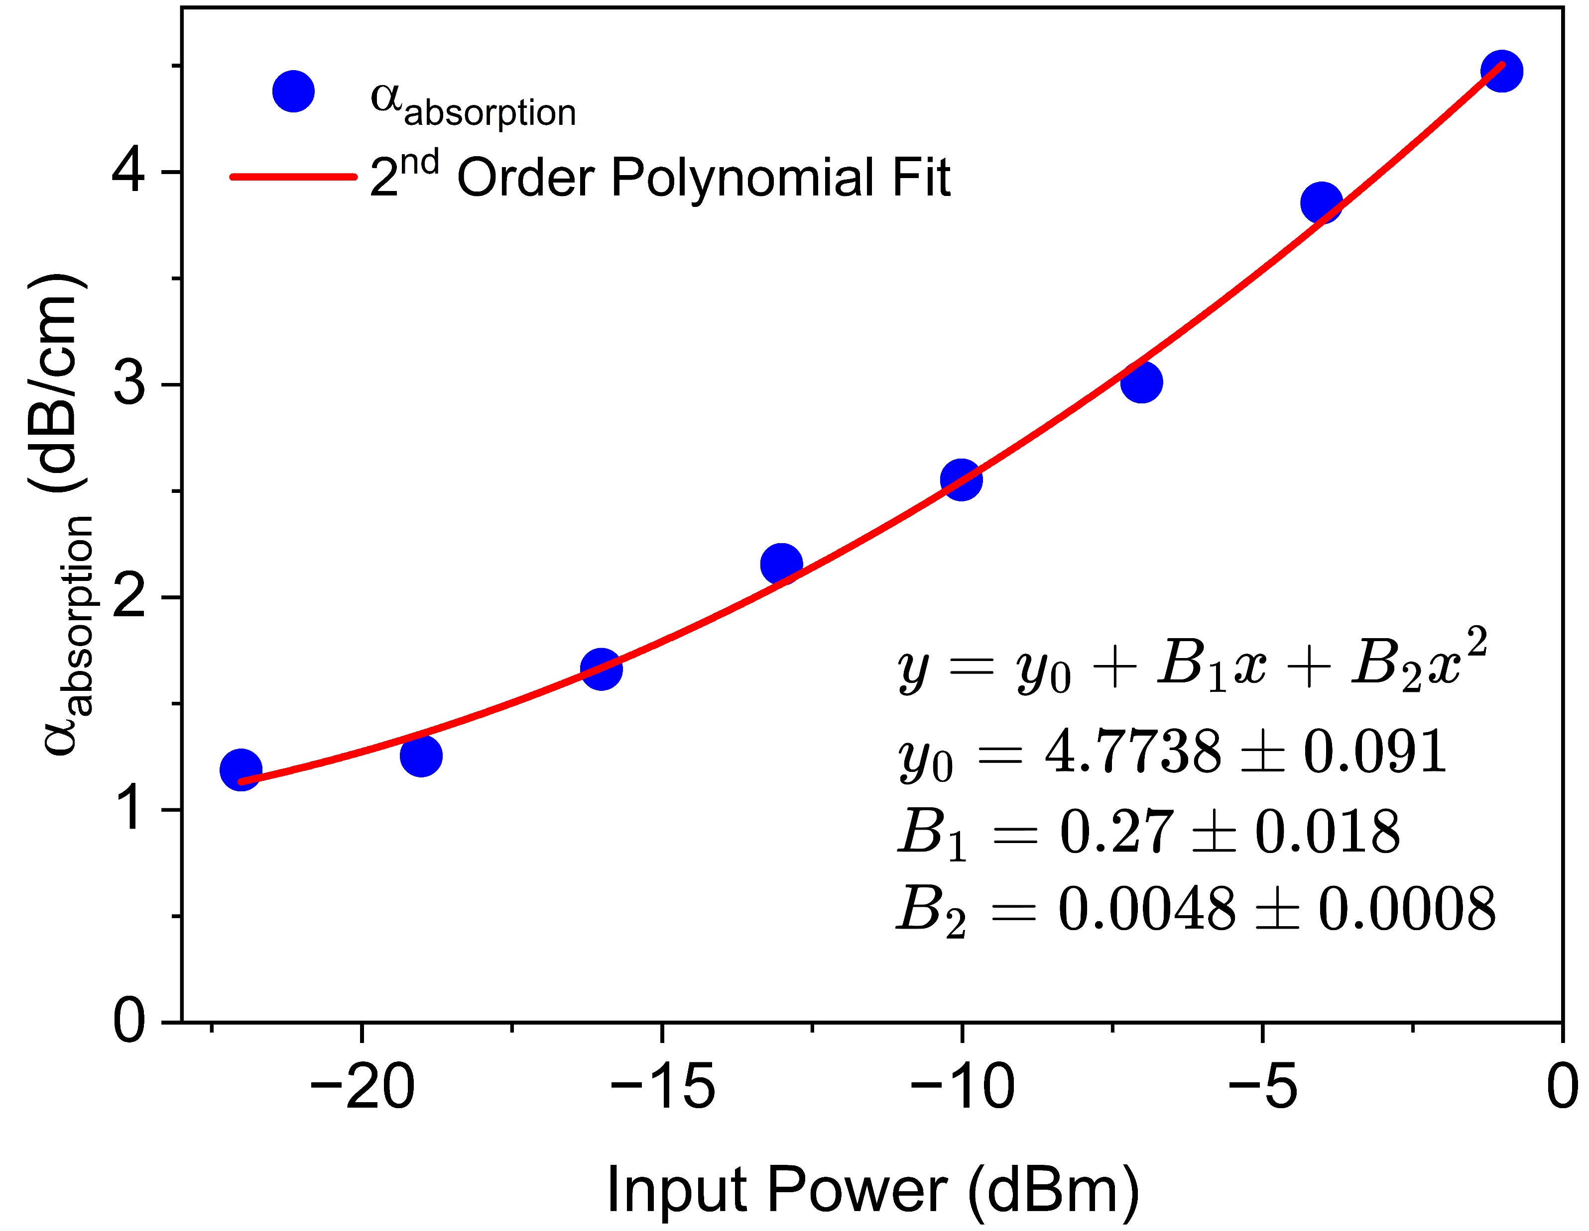
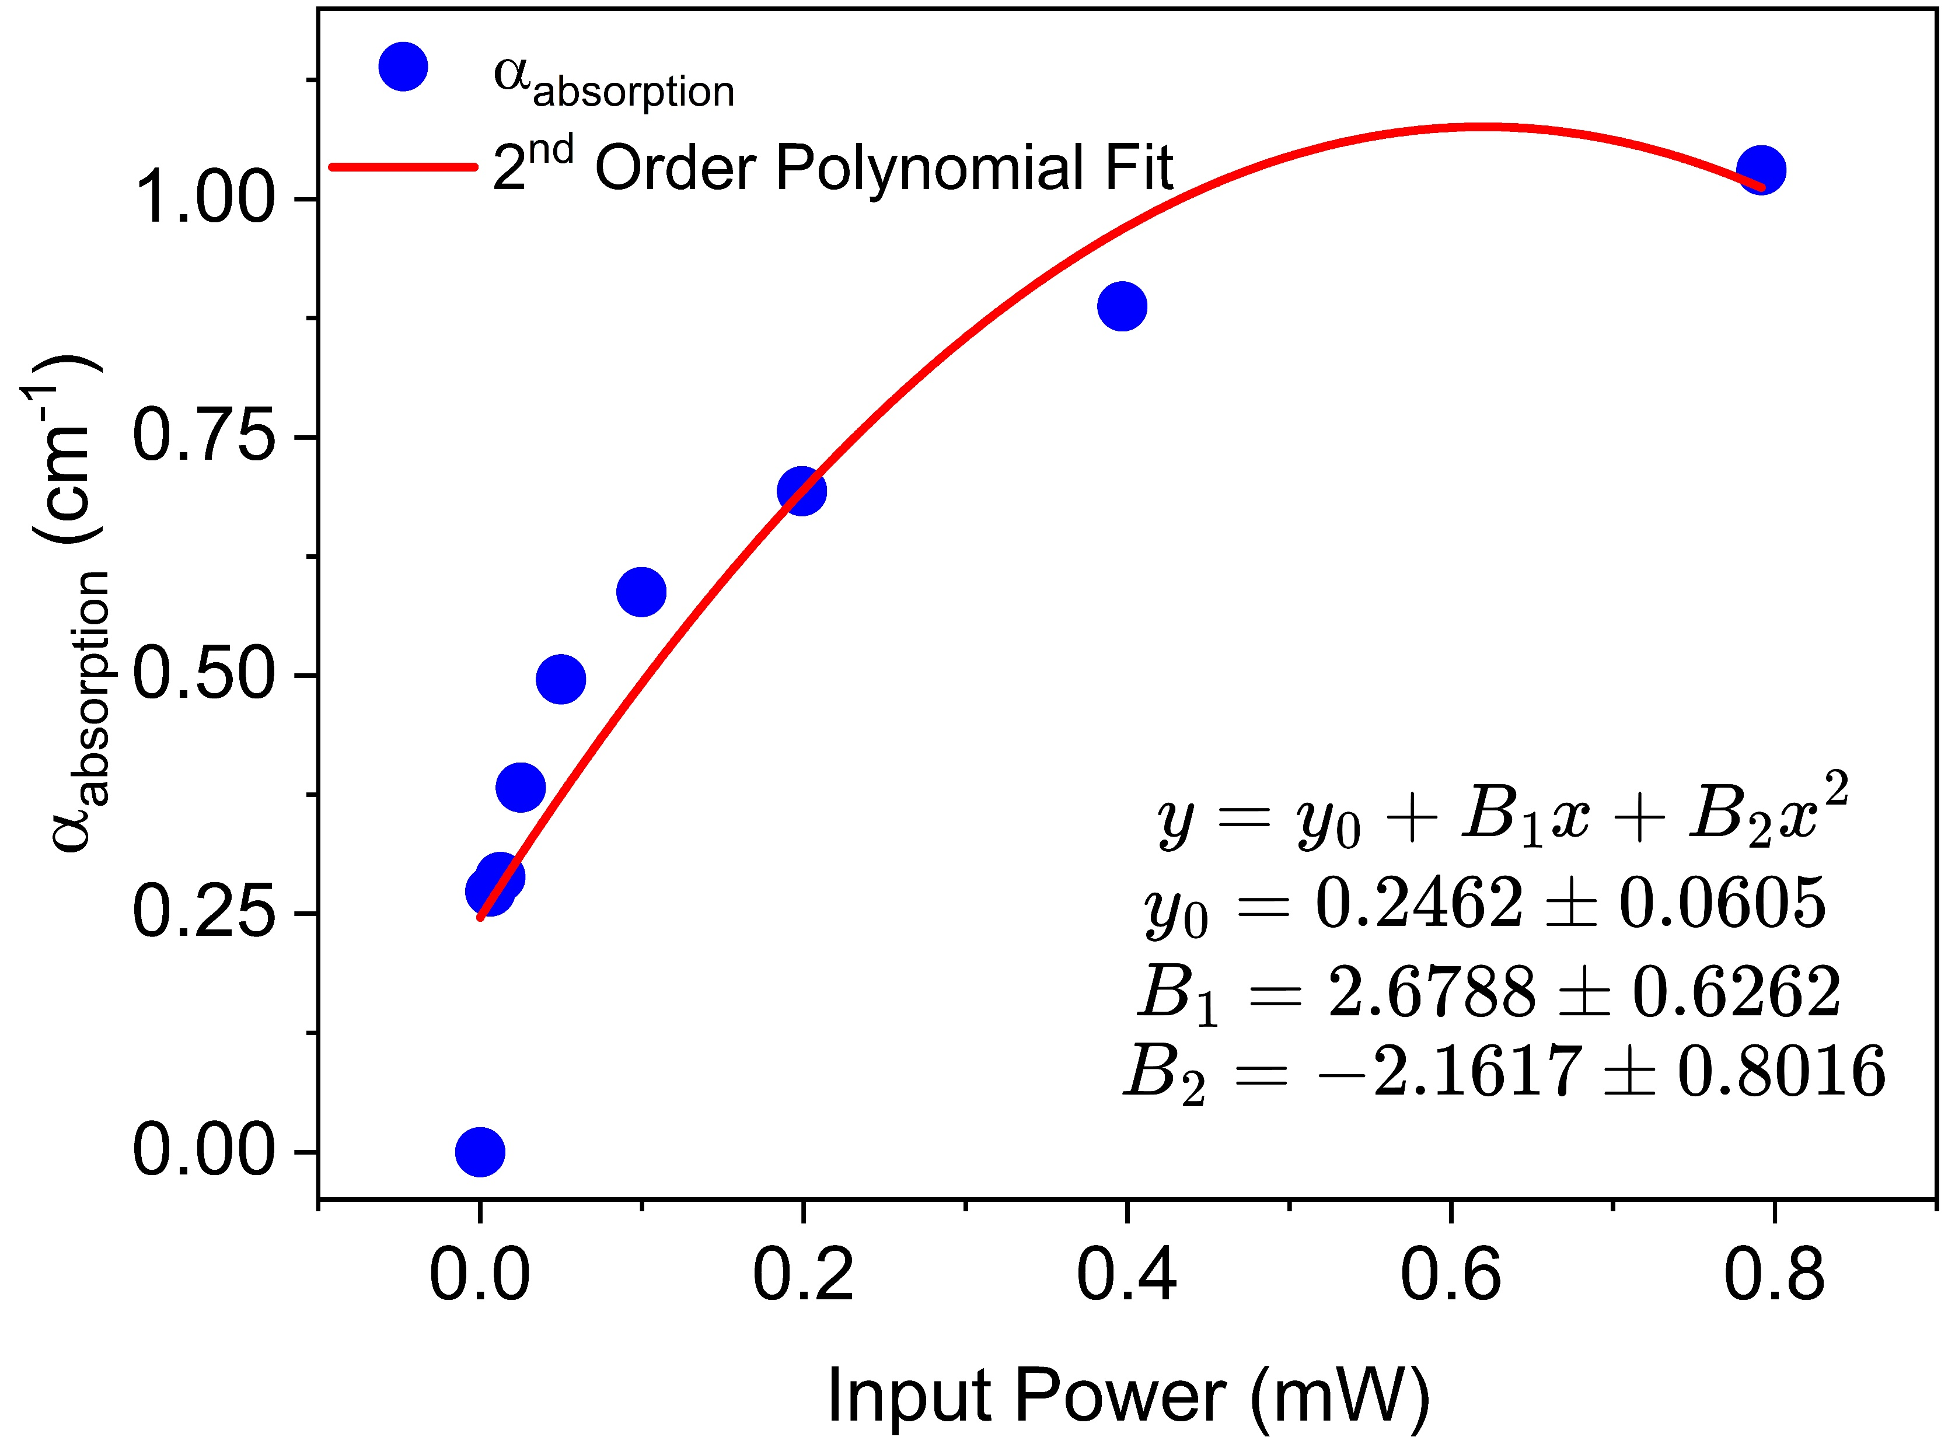
Characterization
Loss Characterization
GSST on SiO₂
(For Large Bend Radius)
Saturable Absorption
14

Slide 12
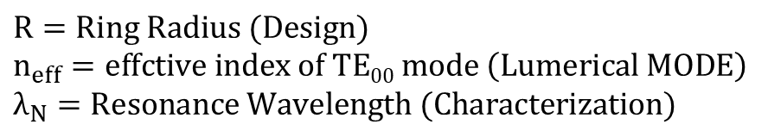
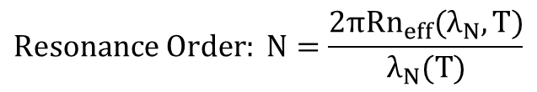
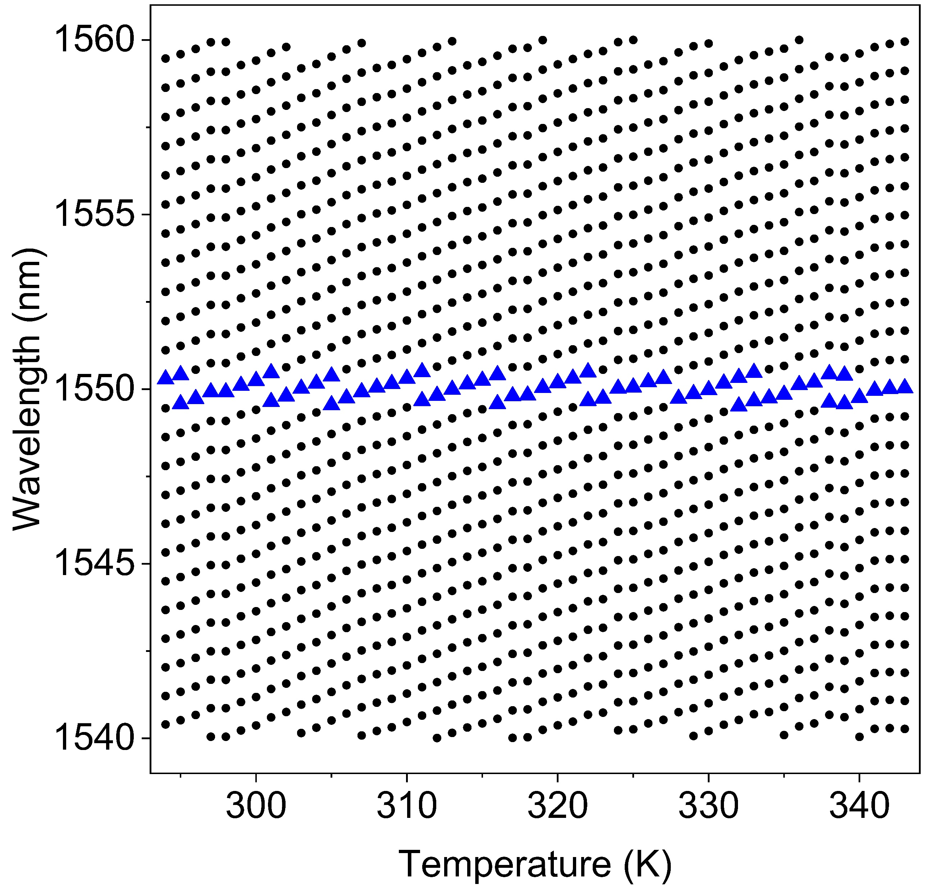
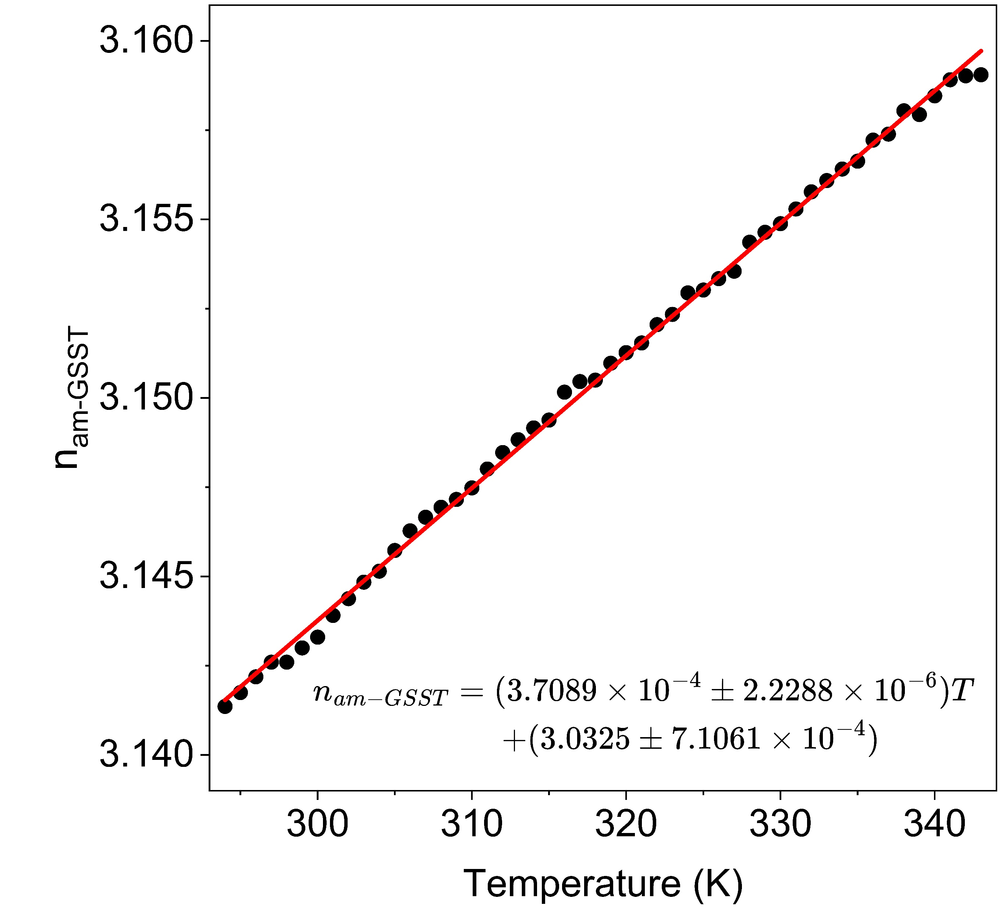
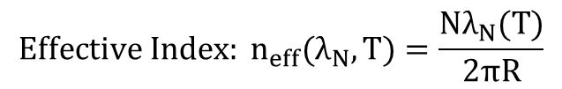
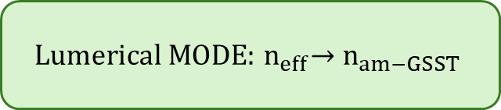
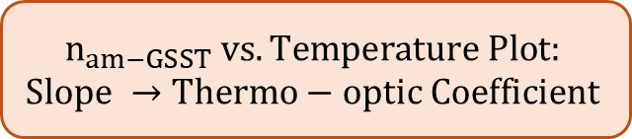
Characterization
Thermo-optic Coefficient of am-GSST (Eliminating Chromatic Dispersion)
GSST on SiO₂
[1] Clark S.A., Culshaw B., Dawnay E.J.C., Day I.E. Thermo-optic phase modulators in SIMOX material. Symp. Integr. Optoelectron. 2000
15

Slide 13
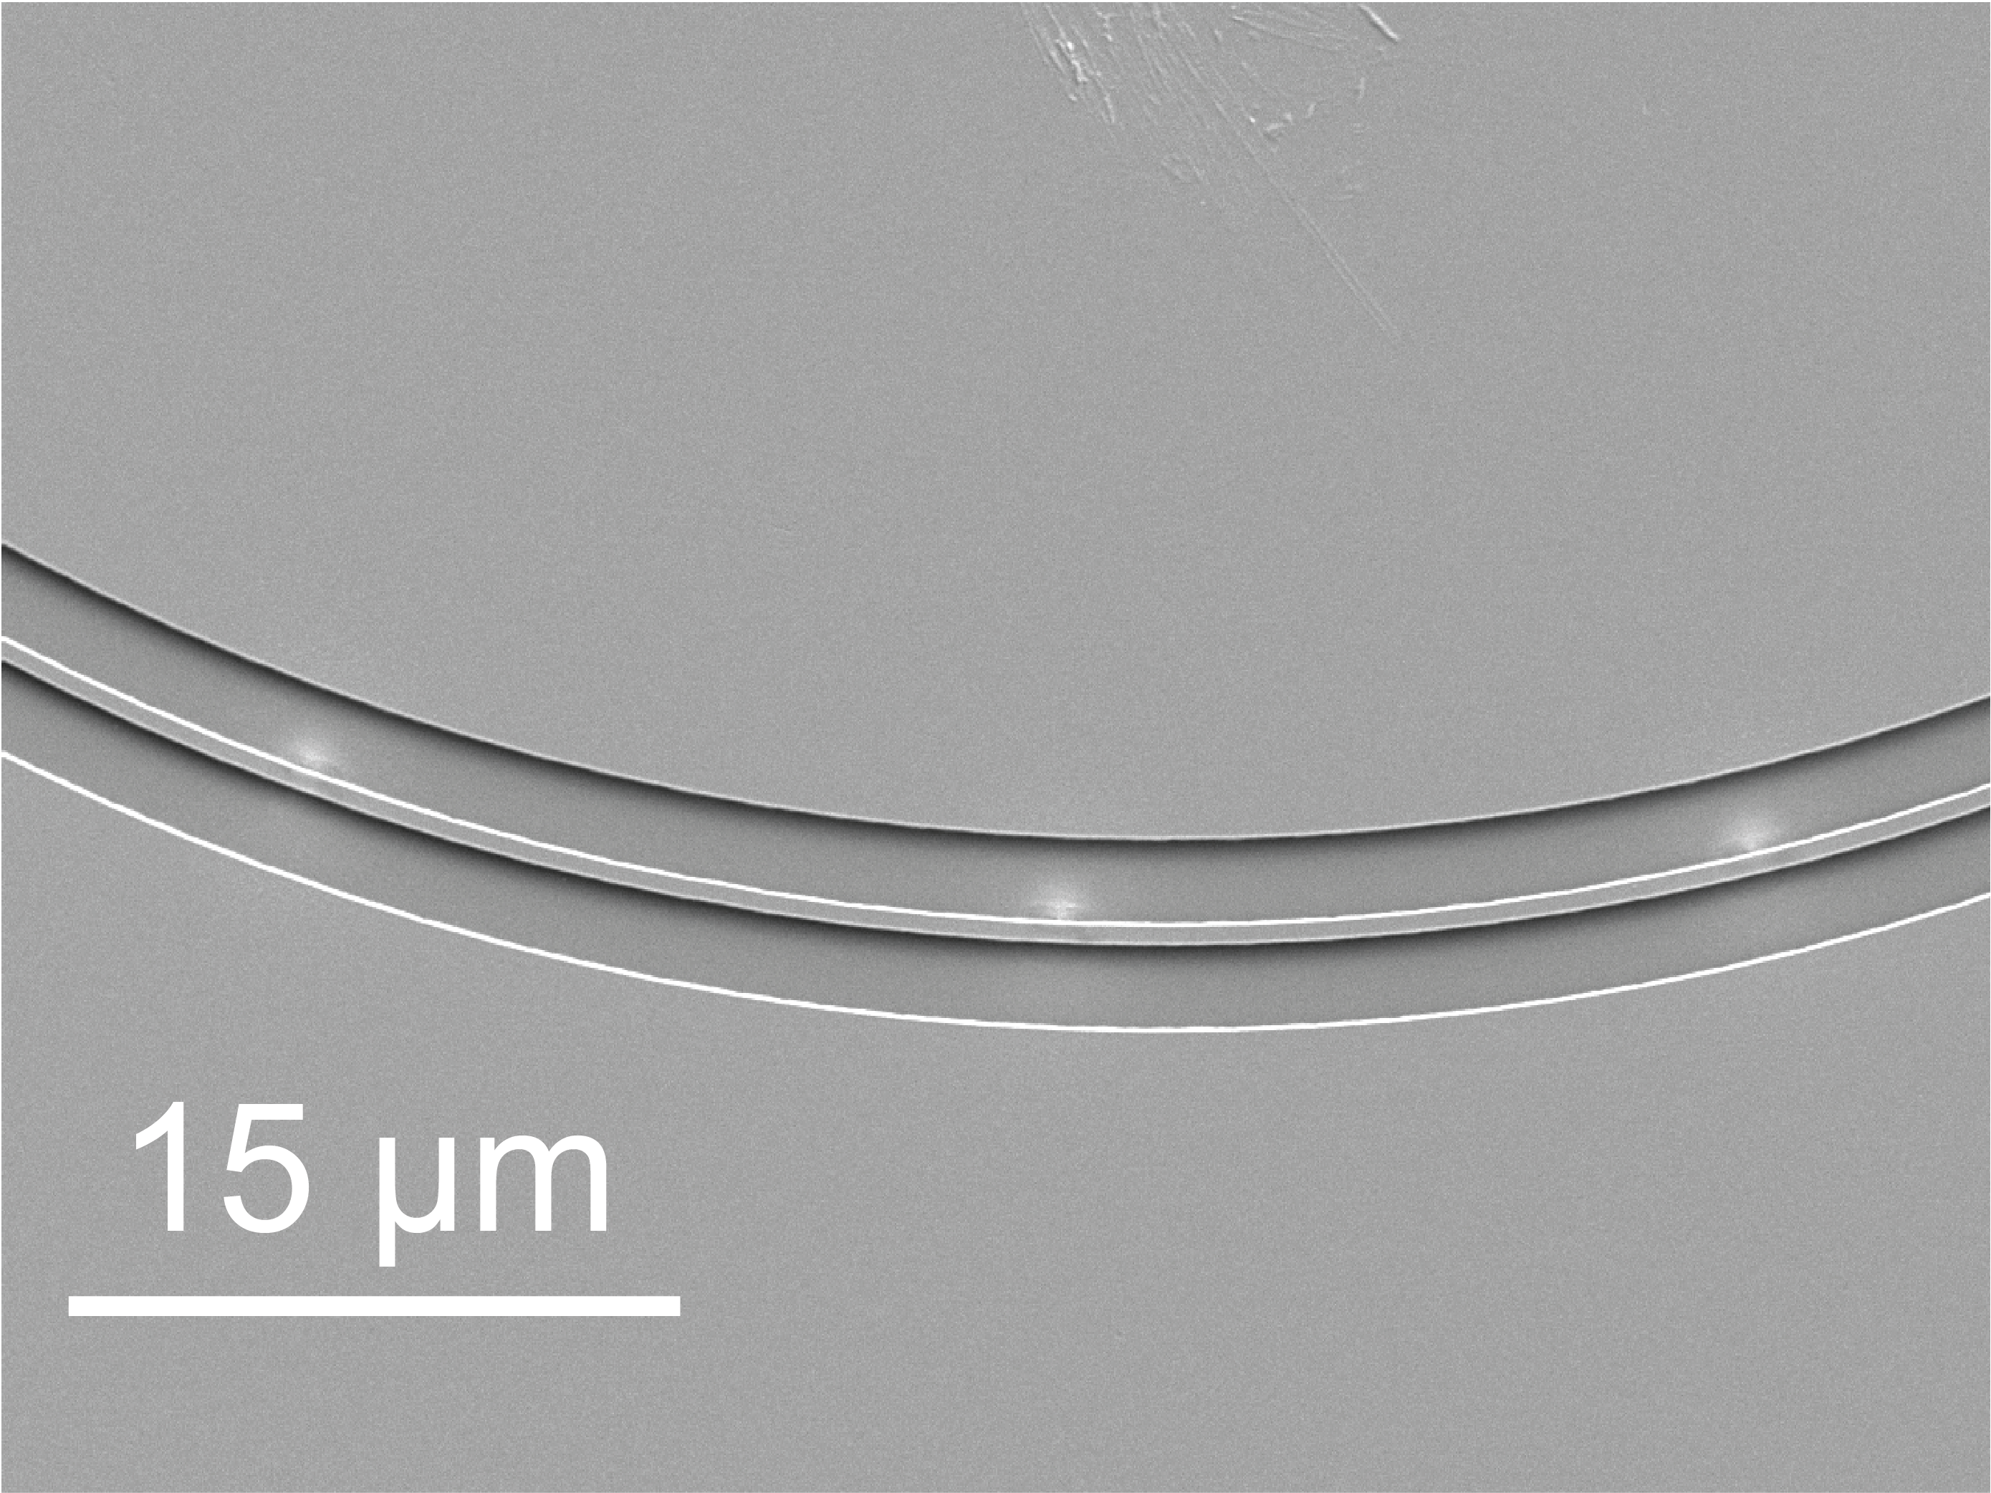
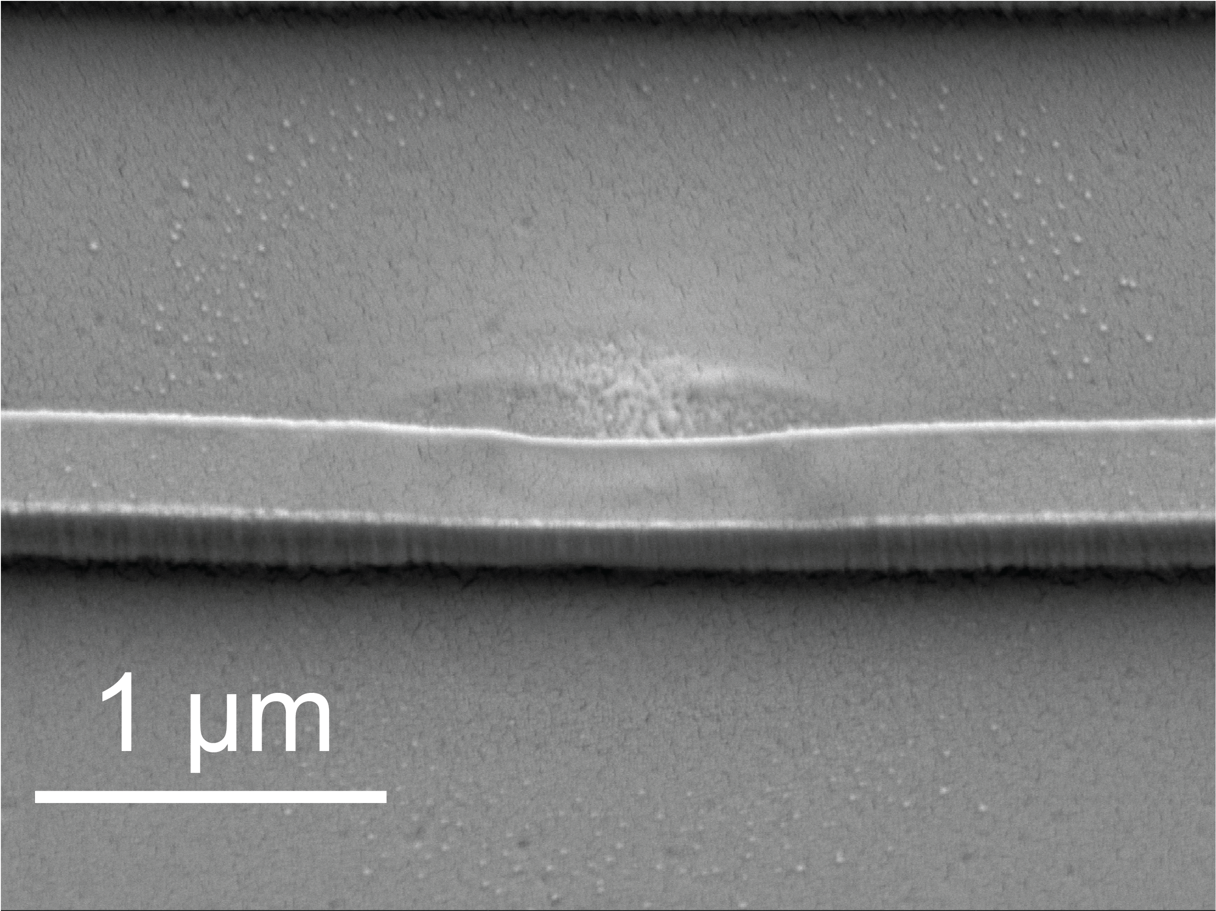

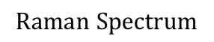
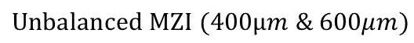
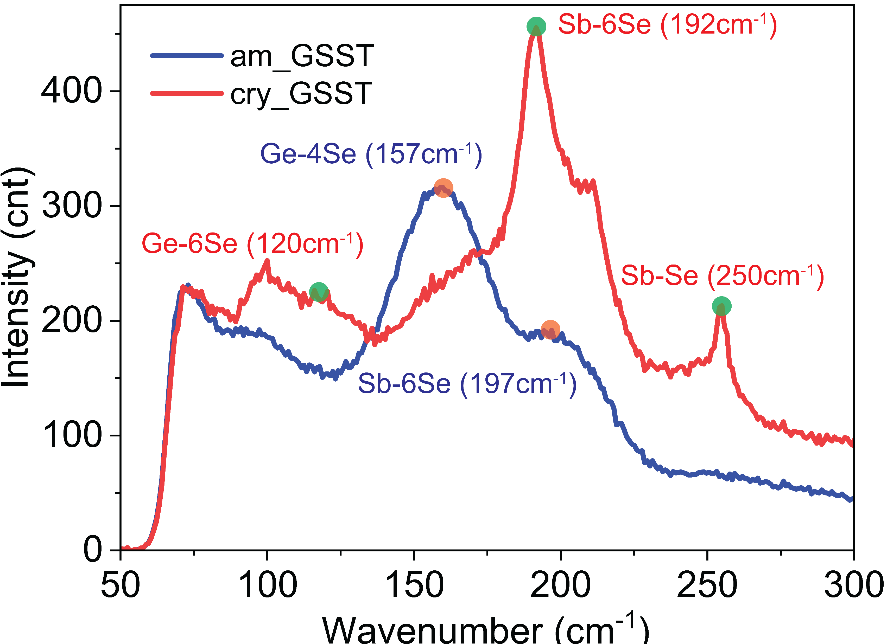
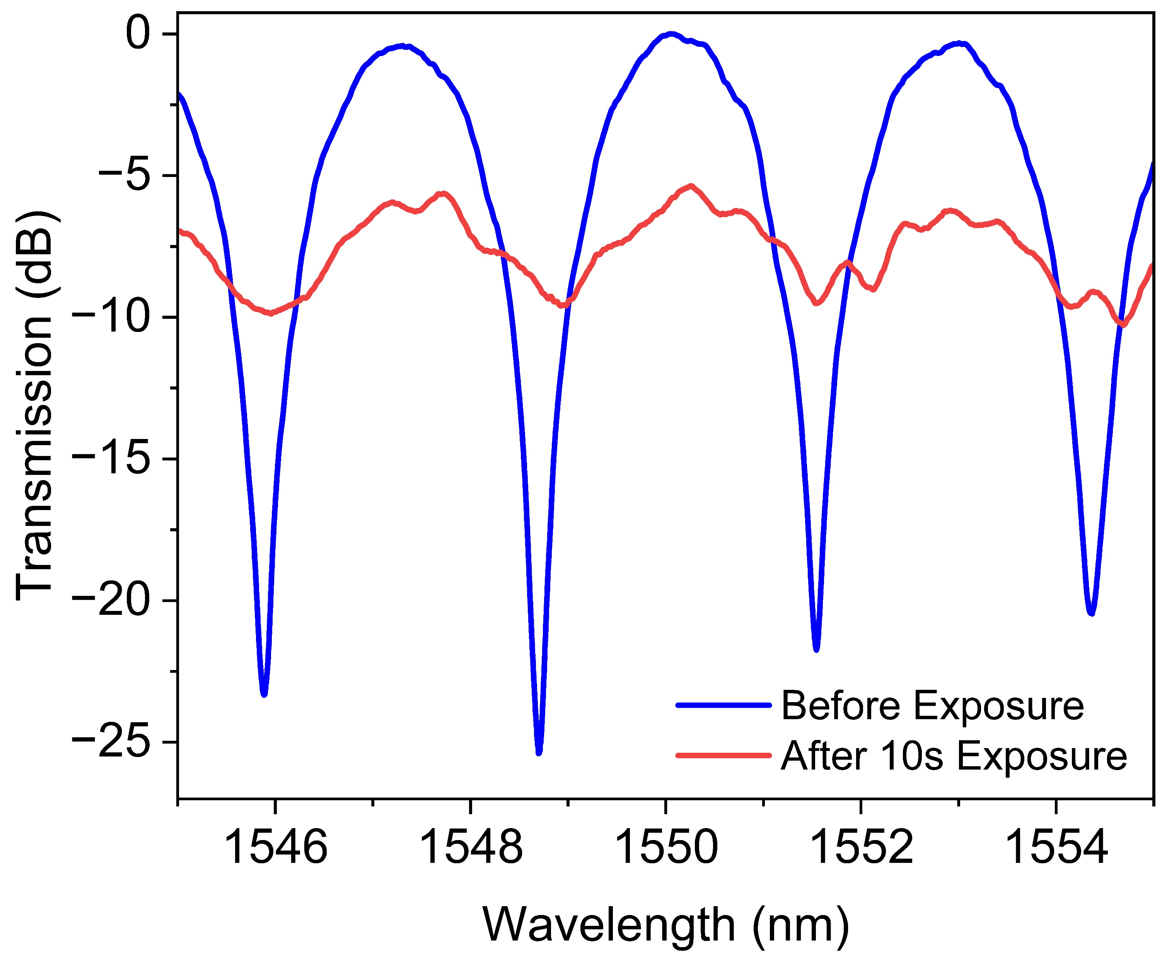

Post Fabrication Tuning
532nm Laser Pulse
Top View
GSST on SiO₂
16

